Slide 1
Getting Set Up

Slide 2
Installation Checklist
Use a hosted environment OR
Install Anaconda
▫ Open up an Anaconda command prompt
▫ conda install pydotplus
▫ pip install tensorflow
OR google colab

Slide 3
Python Basics

Slide 4

Let’s just jump right into some code.

Slide 5
Types of Data

Slide 6
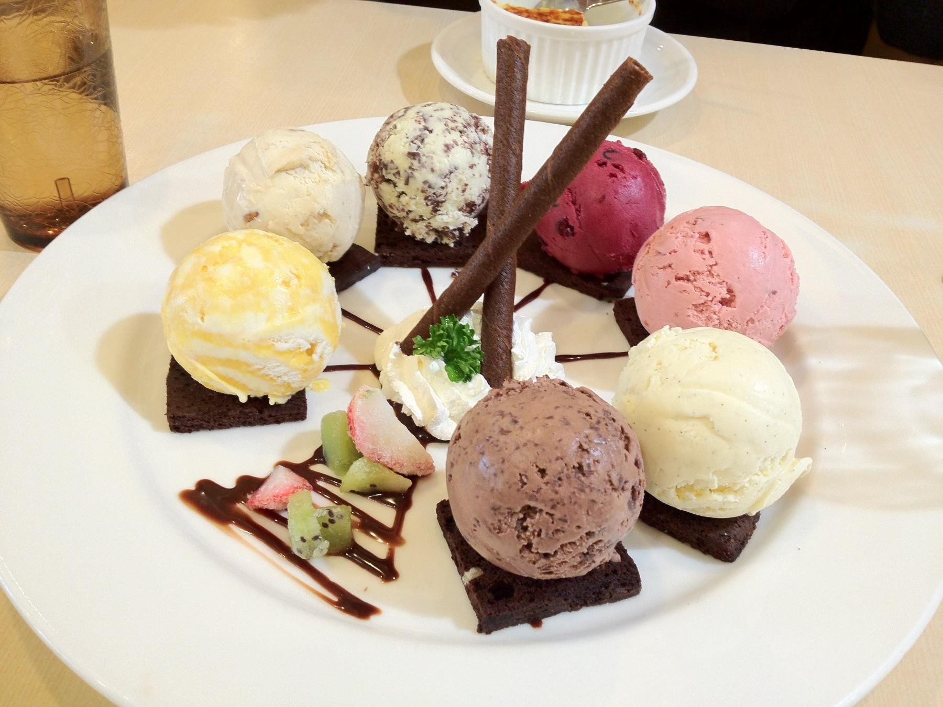
Many Flavors of Data

Slide 7
Major Types of Data
Numerical
Categorical
Ordinal

Slide 8
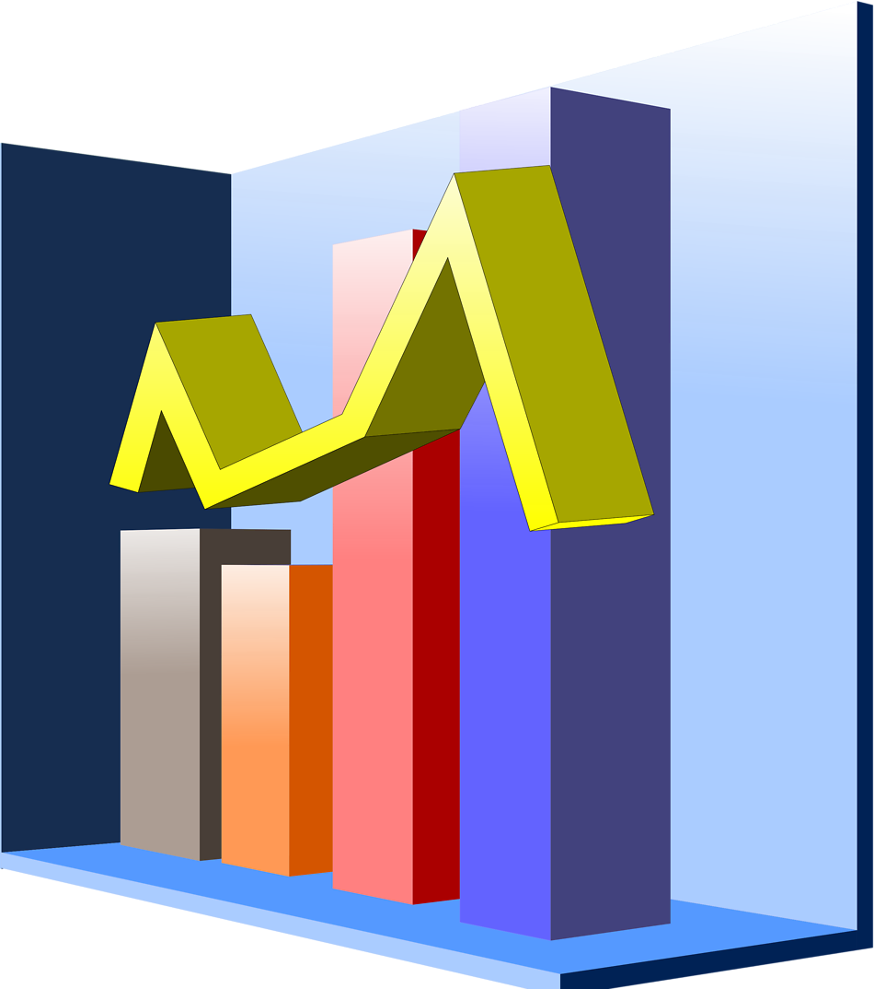
Numerical
Represents some sort of quantitative measurement
▫ Heights of people, page load times, stock prices,
etc.
Discrete Data
▫ Integer based; often counts of some event.
🞄 How many purchases did a customer make in a year?
🞄 How many times did I flip “heads”?
Continuous Data
▫ Has an infinite number of possible values
🞄 How much time did it take for a user to check out?
🞄 How much rain fell on a given day?

Slide 9
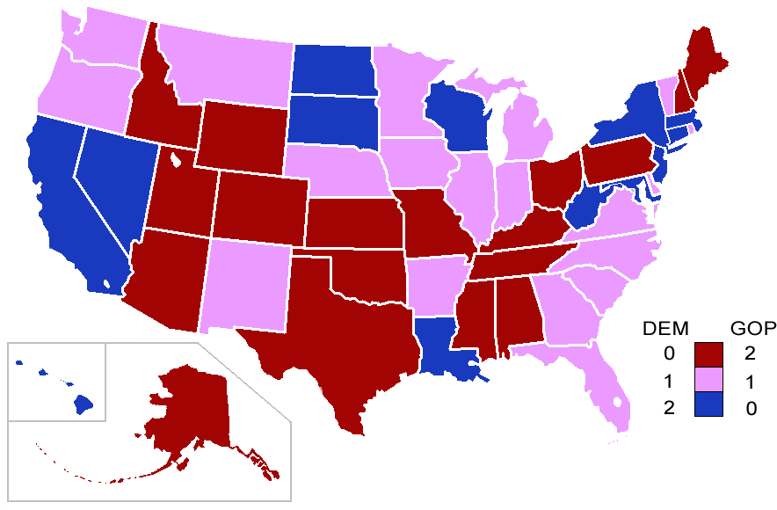
Categorical
Qualitative data that has no inherent mathematical meaning
▫ Gender, Yes/no (binary data), Race, State of Residence, Product Category, Political Party, etc.
You can assign numbers to categories in order to represent them more compactly, but the numbers don’t have mathematical meaning

Slide 10

Ordinal
A mixture of numerical and categorical
Categorical data that has mathematical meaning
Example: movie ratings on a 1-5 scale.
▫ Ratings must be 1, 2, 3, 4, or 5
▫ But these values have mathematical meaning; 1 means it’s a worse movie than a 2.

Slide 11

Quiz time!
Are the following types of data numerical, categorical, or ordinal?
▫ How much gas is in your gas tank
▫ A rating of your overall health where the choices are 1, 2, 3, or 4, corresponding to “poor”, “moderate”, “good”, and “excellent”
▫ The races of your classmates
▫ Ages in years
▫ Money spent in a store

Slide 12
Mean, Median, and Mode

Slide 13
Mean
AKA Average
Sum / number of samples
Example:
▫ Number of children in each house on my street:
0, 2, 3, 2, 1, 0, 0, 2, 0
The MEAN is (0+2+3+2+1+0+0+2+0) / 9 = 1.11

Slide 14
Median
Sort the values, and take the value at the midpoint.
Example:
0, 2, 3, 2, 1, 0, 0, 2, 0
Sort it:
0, 0, 0, 0, 1, 2, 2, 2, 3

Slide 15

Median
If you have an even number of samples, take the average of the two in the middle.
Median is less susceptible to outliers than the mean
▫ Example: mean household income in the US is $72,641, but the median is only $51,939 – because the mean is skewed by a handful of billionaires.
▫ Median better represents the “typical”
American in this example.

Slide 16
Mode
The most common value in a data set
▫ Not relevant to continuous numerical data
Back to our number of kids in each house example:
0, 2, 3, 2, 1, 0, 0, 2, 0
How many of each value are there?
0: 4, 1: 1, 2: 3, 3: 1
The MODE is 0

Slide 17
Standard Deviation and Variance

Slide 18
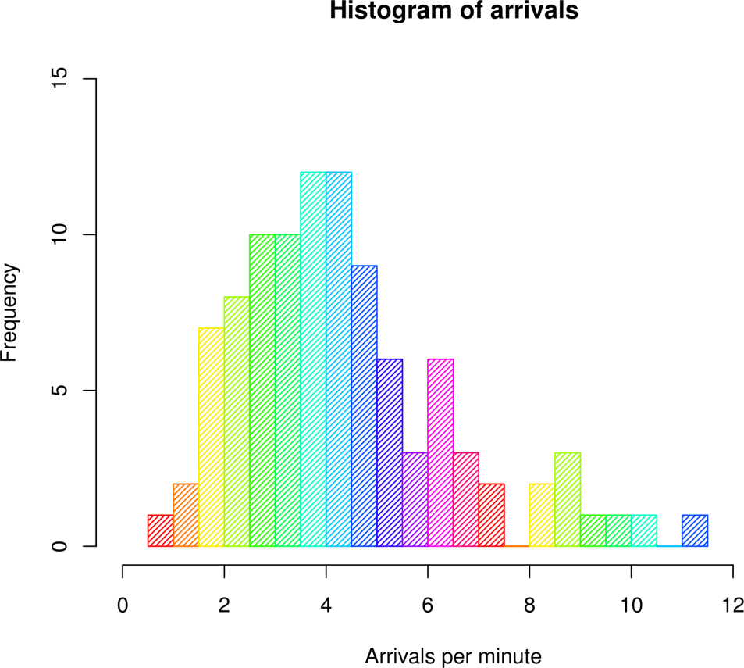
An example of a histogram

Slide 19
Variance measures how “spread-out” the data is.
Variance (𝜎²) is simply the average of the squared differences from the mean
Example: What is the variance of the data set (1, 4, 5, 4, 8)?
▫ First find the mean: (1+4+5+4+8)/5 = 4.4
▫ Now find the differences from the mean: (-3.4, -0.4, 0.6, -0.4, 3.6)
▫ Find the squared differences: (11.56, 0.16, 0.36, 0.16, 12.96)
▫ Find the average of the squared differences:
🞄 𝜎²= (11.56 + 0.16 + 0.36 + 0.16 + 12.96) / 5 = 5.04

Slide 20
Standard Deviation 𝜎 is just the square root of the
variance.
𝜎² = 5.04
2.5
2
1.5
𝜎 = 5.04 = 2.24
So the standard deviation of (1, 4, 5, 4, 8) is 2.24.
1
0.5
0
1 2 3 4 5 6 7
8
This is usually used as a way to identify outliers. Data points that lie more than one standard deviation from the mean can be considered unusual.
You can talk about how extreme a data point is by talking about “how many
sigmas” away from the mean it is.

Slide 21
Population vs. Sample
If you’re working with a sample of data instead of an entire data set (the
entire population)…
▫ Then you want to use the “sample variance” instead of the “population variance”
▫ For N samples, you just divide the squared variances by N-1 instead of N.
▫ So, in our example, we computed the population variance like this:
🞄 𝜎²= (11.56 + 0.16 + 0.36 + 0.16 + 12.96) / 5 = 5.04
▫ But the sample variance would be:
🞄 𝑆²= (11.56 + 0.16 + 0.36 + 0.16 + 12.96) / 4 = 6.3

Slide 22
Fancy Math
Population variance:
2
_{▫ 𝜎2 =} σ 𝑋−𝜇
𝑁
Sample variance:
2
_{▫ 𝑠2 =} σ(𝑋−𝑀)
𝑁−1

Slide 23
Let’s look at another example.

Slide 24
Probability Density Functions

Slide 25
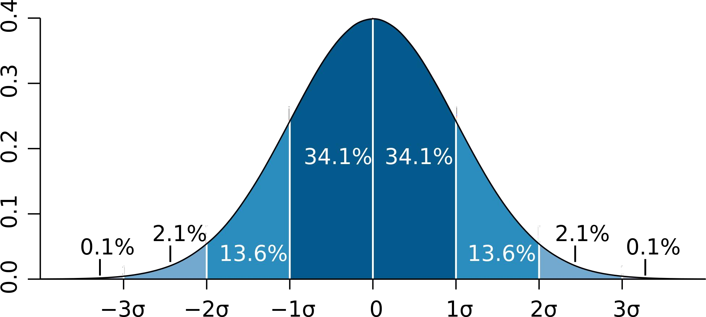
Example: a “normal distribution”

Slide 26
Gives you the probability of a data point falling within some given range of a given value.

Slide 27
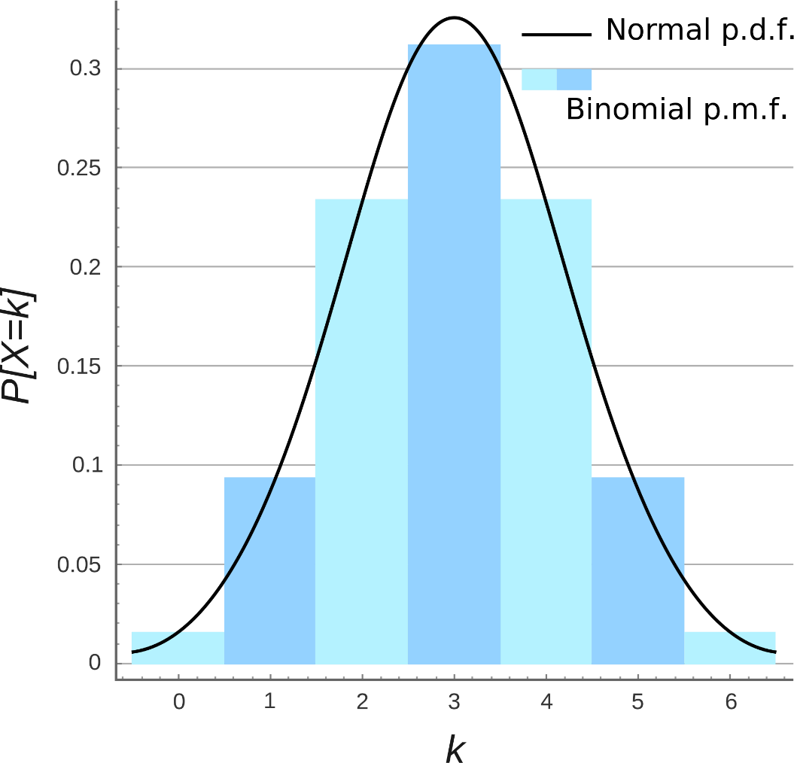
Probability Mass Function

Slide 28
Let’s play with some examples.

Slide 29
Percentiles and Moments

Slide 30
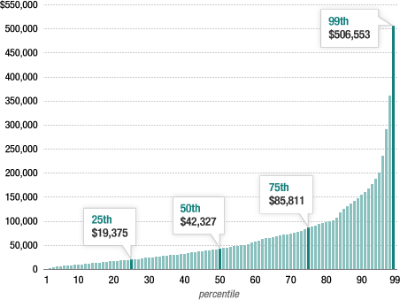
Percentiles
In a data set, what’s the point at which X% of the values are less than
that value?
Example: income distribution

Slide 31
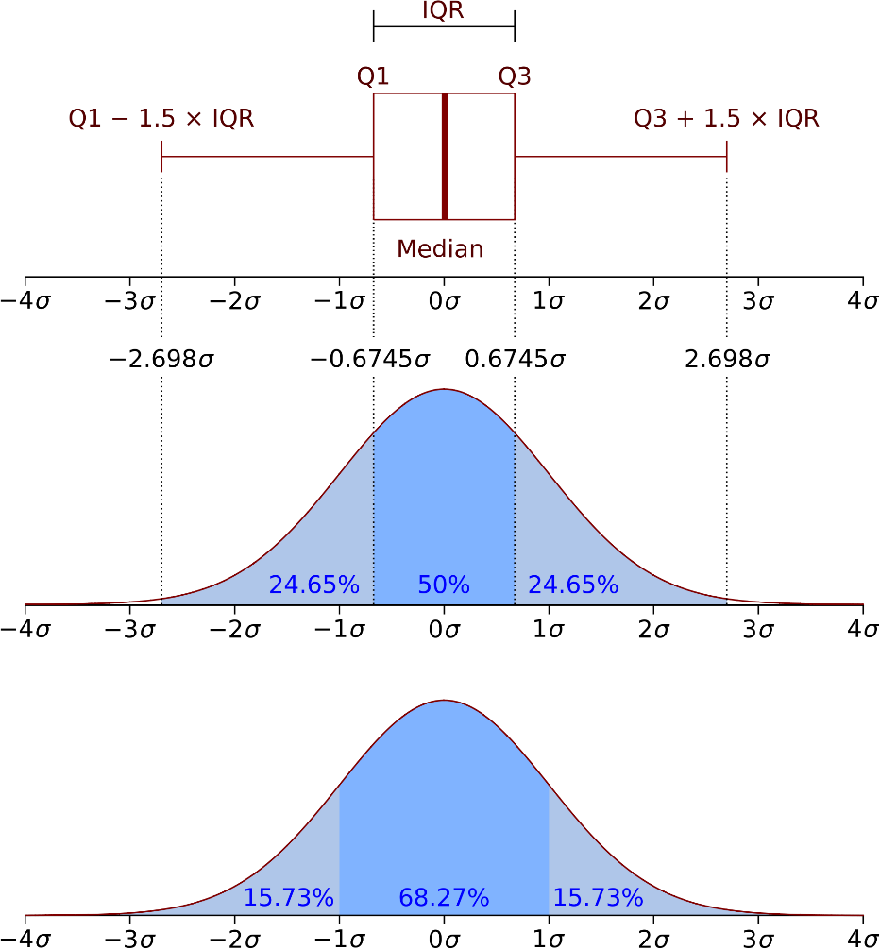
Percentiles in a normal distribution

Slide 32
Let’s look at some examples.

Slide 33
Moments
Quantitative measures of the shape of a probability density function
Mathematically they are a bit hard to wrap your head around:
▫ 𝜇 =
∞
𝑥 − 𝑐 ^{𝑛}𝑓 𝑥 𝑑𝑥 (for moment 𝑛 around value 𝑐)
𝑛
׬−∞
But intuitively, it’s a lot simpler in statistics.

Slide 34
The first moment is the mean.

Slide 35
The second moment is the variance.

Slide 36
Yes, it’s just that simple.

Slide 37
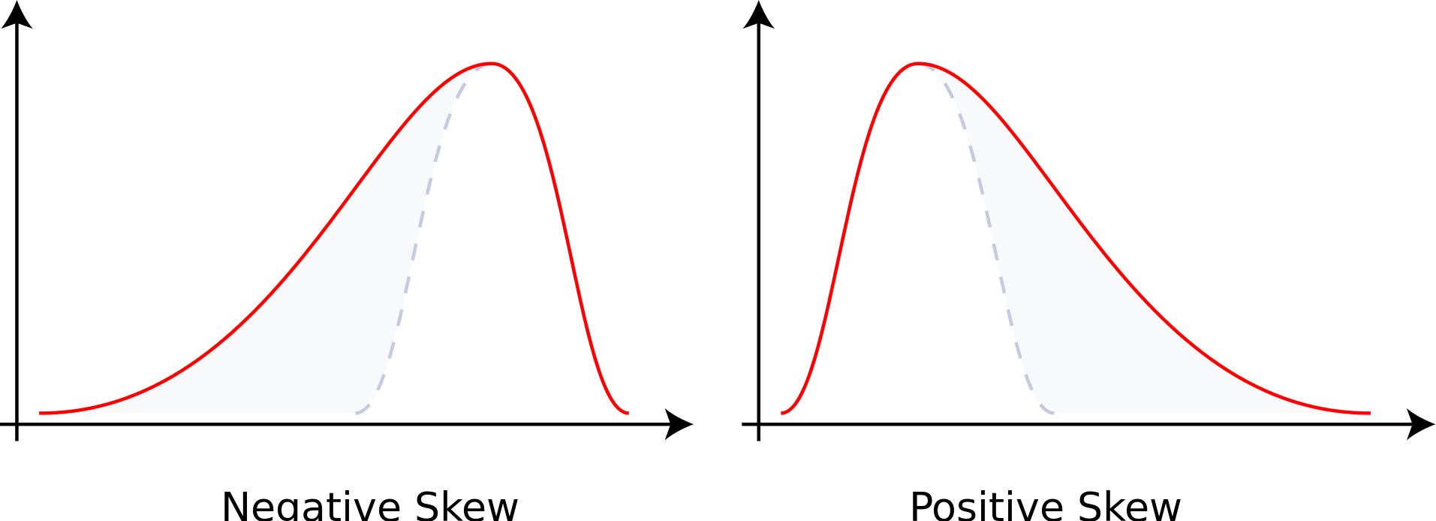
The third moment is “skew” (𝛾)
How “lopsided” is the distribution?
A distribution with a longer tail on the left will be skewed left, and have a negative skew.

Slide 38
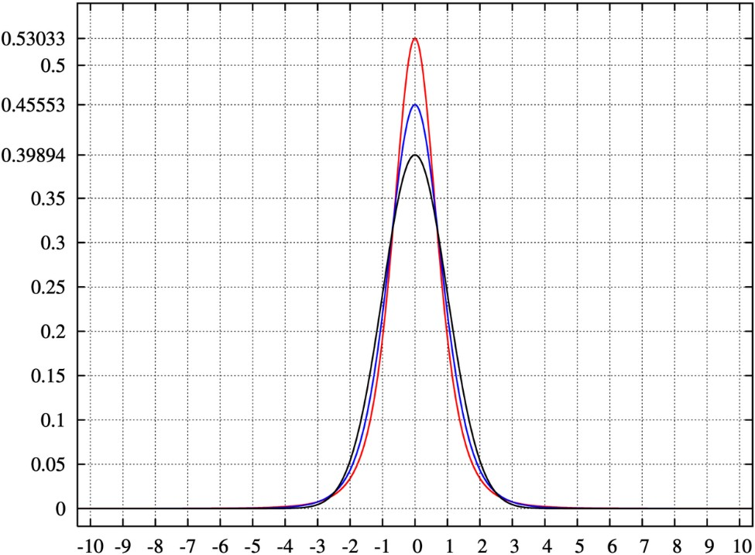
The fourth moment is “kurtosis”
How thick is the tail, and how sharp is the peak, compared to a normal distribution?
Example: higher peaks have higher kurtosis

Slide 39
Let’s compute the 4 moments in Python.

Slide 40
Covariance and Correlation

Slide 41
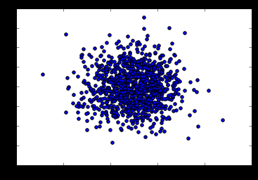
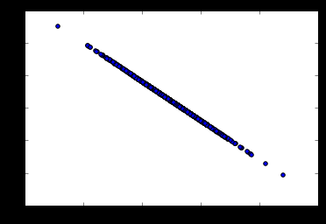
Covariance
Measures how two variables vary in tandem from their means.

Slide 42
Measuring covariance
Think of the data sets for the two variables as high-dimensional vectors
Convert these to vectors of variances from the mean
Take the dot product (cosine of the angle between them) of the two vectors
Divide by the sample size

Slide 43
Interpreting covariance is hard
We know a small covariance, close to 0, means there isn’t much
correlation between the two variables.
And large covariances – that is, far from 0 (could be negative for inverse relationships) mean there is a correlation
But how large is “large”?

Slide 44
That’s where correlation comes in!
Just divide the covariance by the standard deviations of both variables, and that normalizes things.
So a correlation of -1 means a perfect inverse correlation
Correlation of 0: no correlation
Correlation 1: perfect correlation

Slide 45
Remember: correlation does not imply causation!
Only a controlled, randomized experiment can give you insights on causation.
Use correlation to decide what experiments to conduct!

Slide 46
Let’s play with some data.

Slide 47
Conditional Probability

Slide 48
Conditional Probability
If I have two events that depend on each other, what’s the probability
that both will occur?
Notation: P(A,B) is the probability of A and B both occurring
P(B|A) : Probability of B given that A has occurred
We know:
P(B|A) = ^{P(A,B)}
P(A)

Slide 49
For example
I give my students two tests. 60% of my students passed both tests, but the first test was easier – 80% passed that one. What percentage of students who passed the first test also passed the second?
A = passing the first test, B = passing the second test
So we are asking for P(B|A) – the probability of B given A
P(B|A) = ^{P(A,B)} = ^{0.6} = 0.75
P(A) 0.8
75% of students who passed the first test passed the second.

Slide 50
Let’s do another example using Python.

Slide 51
Bayes’ Theorem

Slide 52
Bayes’ Theorem
Now that you understand conditional probability, you can understand Bayes’
Theorem:
𝑃 𝐴 𝑃 𝐵 𝐴
𝑃 𝐴 𝐵 =
𝑃 𝐵
In English – the probability of A given B, is the probability of A times the probability of B given A over the probability of B.
The key insight is that the probability of something that depends on B depends very much on the base probability of B and A. People ignore this all the time.

Slide 53
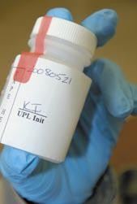
Bayes’ Theorem to the rescue
Drug testing is a common example. Even a “highly accurate” drug test can produce more false positives than true positives.
Let’s say we have a drug test that can accurately identify users of a drug 99% of the time, and accurately has a negative result for 99% of non- users. But only 0.3% of the overall population actually uses this drug.

Slide 54
Bayes’ Theorem to the rescue
Event A = Is a user of the drug, Event B = tested positively for the drug.
We can work out from that information that P(B) is 1.3% (0.99 * 0.003 +
0.01 * 0.997 – the probability of testing positive if you do use, plus the
probability of testing positive if you don’t.)
𝑃 𝐴 𝑃 𝐵 𝐴 0.003 ∗0.99
= = = 22.8%
𝑃 𝐵 0.013
𝑃 𝐴 𝐵
So the odds of someone being an actual user of the drug given that they tested positive is only 22.8%!
Even though P(B|A) is high (99%), it doesn’t mean P(A|B) is high.

Slide 55
Linear Regression

Slide 56
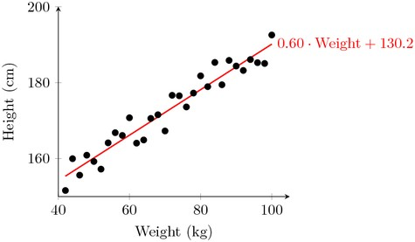
Linear Regression
Fit a line to a data set of observations
Use this line to predict unobserved values
I don’t know why they call it “regression.” It’s really misleading. You can use it to predict points in the future, the past, whatever. In fact time usually has nothing to do with it.

Slide 57
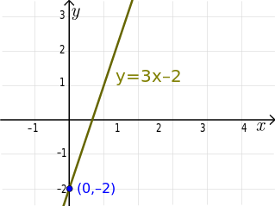
Linear Regression: How does it work?
Usually using “least squares”
Minimizes the squared-error between each point and the line
Remember the slope-intercept equation of a line? y=mx+b
The slope is the correlation between the two variables times the standard deviation in Y, all divided by the standard deviation in X.
▫ Neat how standard deviation how some real mathematical
meaning, eh?
The intercept is the mean of Y minus the slope times the mean of X
But Python will do all that for you.

Slide 58
Linear Regression: How does it work?
Least squares minimizes the sum of squared errors.
This is the same as maximizing the likelihood of the observed data if you start thinking of the problem in terms of probabilities and probability distribution functions
This is sometimes called “maximum likelihood estimation”

Slide 59
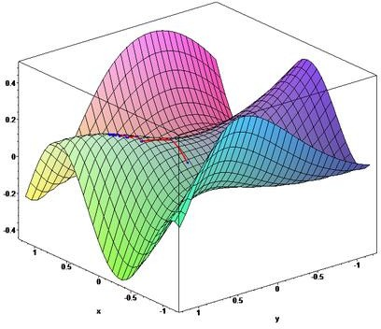
More than one way to do it
Gradient Descent is an alternate method to least squares.
Basically iterates to find the line that best follows the contours defined by the data.
Can make sense when dealing with 3D data
Easy to try in Python and just compare the results to least squares
▫ But usually least squares is a perfectly good choice.

Slide 60
Measuring error with r-squared
How do we measure how well our line fits our data?
R-squared (aka coefficient of determination) measures:
The fraction of the total variation in Y that is captured by the model

Slide 61
Computing r-squared
1.0 -
𝑠𝑢𝑚 𝑜𝑓 𝑠𝑞𝑢𝑎𝑟𝑒𝑑 𝑒𝑟𝑟𝑜𝑟𝑠
𝑠𝑢𝑚 𝑜𝑓 𝑠𝑞𝑢𝑎𝑟𝑒𝑑 𝑣𝑎𝑟𝑖𝑎𝑡𝑖𝑜𝑛 𝑓𝑟𝑜𝑚 𝑚𝑒𝑎𝑛

Slide 62
Interpreting r-squared
Ranges from 0 to 1
0 is bad (none of the variance is captured), 1 is good (all of the variance is captured).

Slide 63
Let’s play with an example.

Slide 64
Polynomial Regression

Slide 65
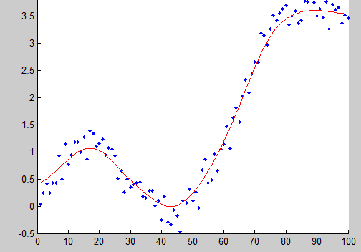
Why limit ourselves to straight lines?
Not all relationships are linear.
Linear formula: y = mx + b
▫ This is a “first order” or “first degree”
polynomial, as the power of x is 1
Second order polynomial: 𝑦 = 𝑎𝑥² +
𝑏𝑥 + 𝑐
Third order: 𝑦 = 𝑎𝑥³ + 𝑏𝑥² + 𝑐𝑥 + 𝑑
Higher orders produce more complex curves.

Slide 66
Beware overfitting
Don’t use more degrees than you need
Visualize your data first to see how complex of a curve there might really be
Visualize the fit – is your curve going out of its way to accommodate outliers?
A high r-squared simply means your curve fits your training data well; but it may not be a good predictor.
Later we’ll talk about more principled ways to detect overfitting
(train/test)

Slide 67
Let’s play with an example
numpy.polyfit() makes it easy.

Slide 68
Multiple Regression

Slide 69
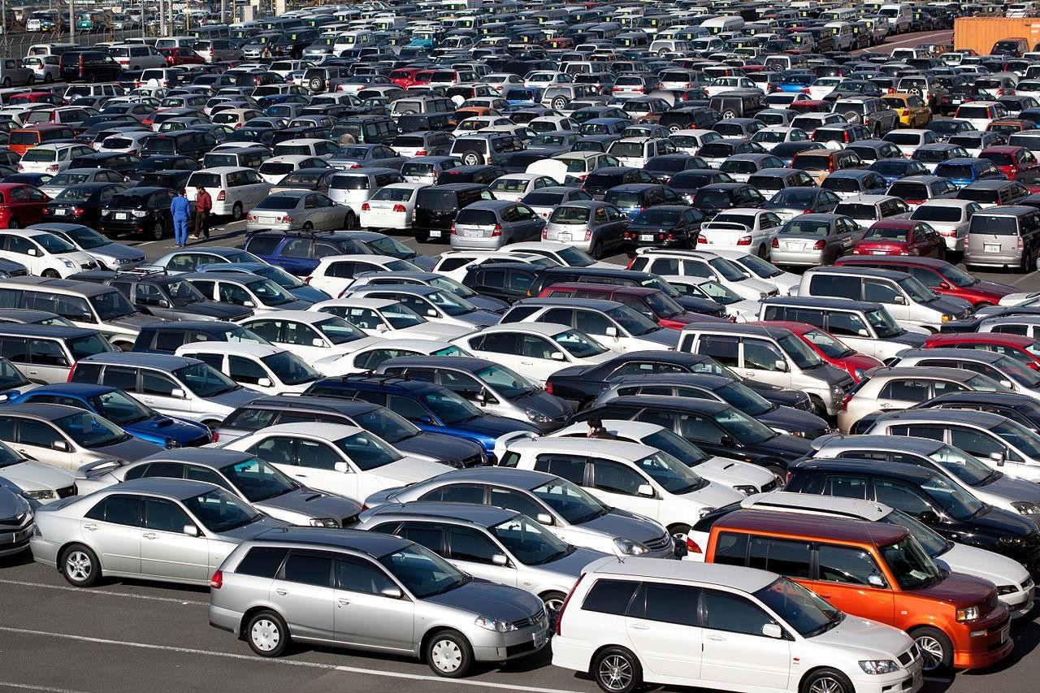
Multiple Regression
What if more than one variable influences the one you’re interested in?
Example: predicting a price for a car based on its many attributes (body style, brand, mileage, etc.)
If you also have multiple dependent variables – things you’re trying to predict – that’s “multivariate regression”

Slide 70
Still uses least squares
We just end up with coefficients for each factor.
▫ For example, 𝑝𝑟𝑖𝑐𝑒 = 𝛼 + 𝛽₁mileage + 𝛽₂age + 𝛽₃doors
▫ These coefficients imply how important each factor is (if the data is all normalized!)
▫ Get rid of ones that don’t matter!
Can still measure fit with r-squared
Need to assume the different factors are not themselves dependent on each other.

Slide 71
Let’s dive into an example.
The statsmodel package makes it easy.

Slide 72
Multi-Level Models

Slide 73
Multi-Level Models
The concept is that some effects happen at various levels.
Example: your health depends on a hierarchy of the health of your cells, organs, you as a whole, your family, your city, and the world you live in.
Your wealth depends on your own work, what your parents did, what your grandparents did, etc.
Multi-level models attempt to model and account for these interdependencies.

Slide 74
Modeling multiple levels
You must identify the factors that affect the outcome you’re trying to
predict at each level.
For example – SAT scores might be predicted based on the genetics of individual children, the home environment of individual children, the crime rate of the neighborhood they live in, the quality of the teachers in their school, the funding of their school district, and the education policies of their state.
Some of these factors affect more than one level. For example, crime rate might influence the home environment too.

Slide 75

Doing this is hard.
I just want you to be aware of the concept, as multi-level models showed up on some data science job requirements I’ve seen.
You’re not ready for it yet. Entire advanced statistics and modeling courses exist on this one topic alone.
Thick books exist on it too, when you’re ready.

Slide 76
Supervised and Unsupervised Machine Learning
And the concept of train/test

Slide 77
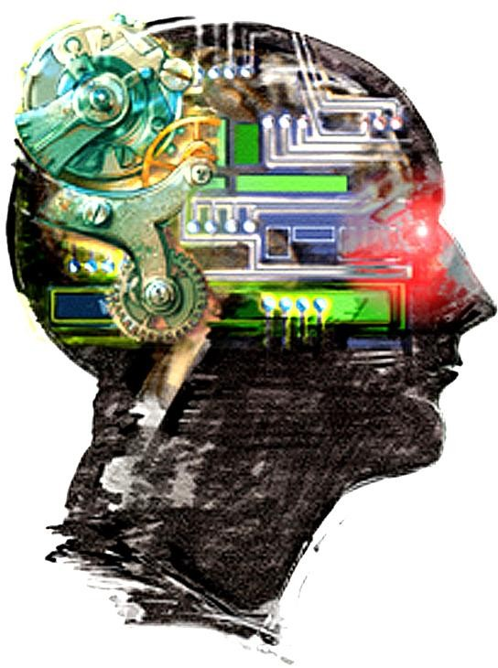
What is machine learning?
Algorithms that can learn from observational data, and can make predictions based on it.
Yeah, that’s pretty much what your own brain does too.

Slide 78
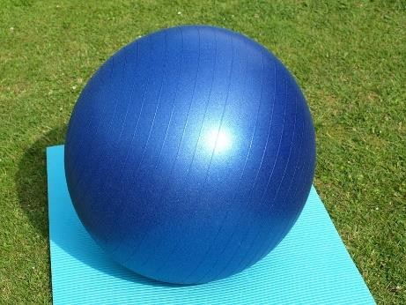
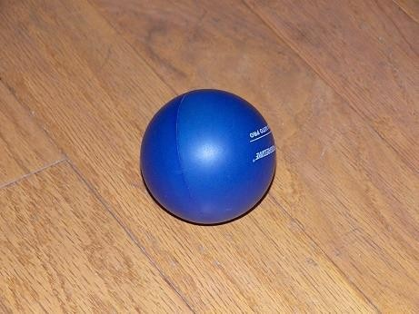
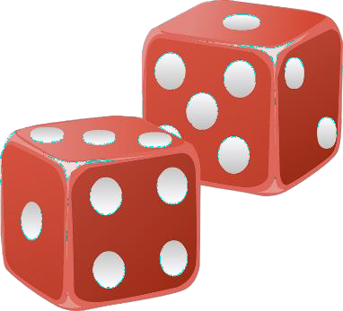
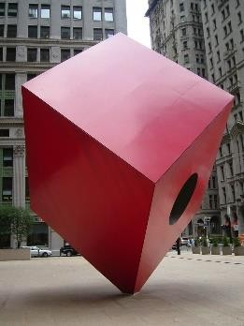
Unsupervised Learning
The model is not given any “answers” to learn from; it must make sense
of the data just given the observations themselves.
Example: group (cluster) some objects together into 2 different sets. But
I don’t tell you what the “right” set is for any object ahead of time.
Do I want big and small things? Round and square things? Red and blue things? Unsupervised learning could give me any of those results.

Slide 79
Unsupervised Learning
Unsupervised learning sounds awful! Why use it?
Maybe you don’t know what you’re looking for – you’re looking for
latent variables.
Example: clustering users on a dating site based on their information
and behavior. Perhaps you’ll find there are groups of people that emerge that don’t conform to your known stereotypes.
Cluster movies based on their properties. Perhaps our current concepts of genre are outdated?
Analyze the text of product descriptions to find the terms that carry the most meaning for a certain category.

Slide 80
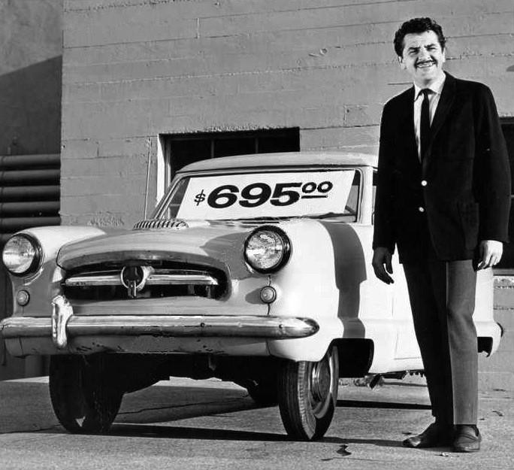
Supervised Learning
In supervised learning, the data the algorithm
“learns” from comes with the “correct” answers.
The model created is then used to predict the answer for new, unknown values.
Example: You can train a model for predicting car prices based on car attributes using historical sales data. That model can then predict the optimal price for new cars that haven’t been sold before.

Slide 81

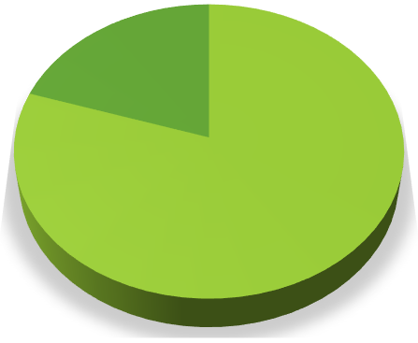




Evaluating Supervised Learning
If you have a set of training data that includes the value you’re trying to predict – you don’t have to guess if the resulting model is good or not.
If you have enough training data, you can split it into two parts: a training set and a test set.
You then train the model using only the training set
And then measure (using r-squared or some other metric) the model’s accuracy by asking it to predict values for the test set, and compare that to the known, true values.
Car Sales Data
Test set
20%
Training set 80%
Training set
Test set

Slide 82
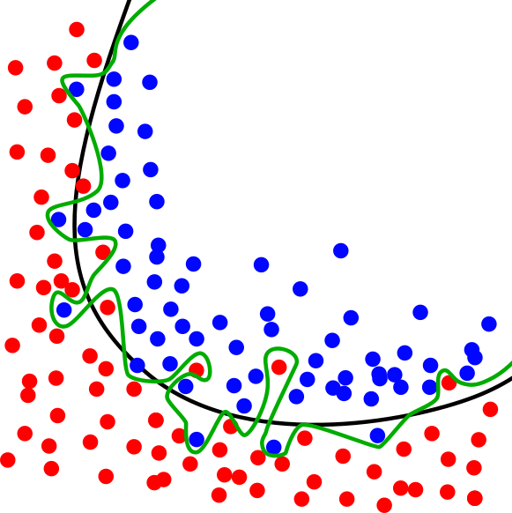
Train / Test in practice
Need to ensure both sets are large enough to contain representatives of all the variations and outliers in the data you care about
The data sets must be selected randomly
Train/test is a great way to guard against overfitting

Slide 83
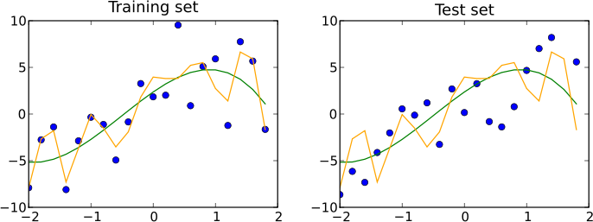
Train/Test is not Infallible
Maybe your sample sizes are too small
Or due to random chance your train and test sets look remarkably similar
Overfitting can still happen

Slide 84
K-fold Cross Validation
One way to further protect against overfitting is K-fold cross validation
Sounds complicated. But it’s a simple idea:
▫ Split your data into K randomly-assigned segments
▫ Reserve one segment as your test data
▫ Train on each of the remaining K-1 segments and measure their performance against the test set
▫ Take the average of the K-1 r-squared scores

Slide 85
Let’s go do some training and testing.

Slide 86
Bayesian Methods

Slide 87
Remember Bayes’ Theorem?
₌ 𝑃 𝐴 𝑃(𝐵|𝐴)
𝑃 𝐴 𝐵
𝑃 𝐵
Let’s use it for machine learning! I want a spam classifier.
Example: how would we express the probability of an email being spam if it
contains the word “free”?
_{𝐹𝑟𝑒𝑒) =} 𝑃 𝑆𝑝𝑎𝑚 𝑃 𝐹𝑟𝑒𝑒
𝑆𝑝𝑎𝑚)
𝑃 𝑆𝑝𝑎𝑚
𝑃 𝐹𝑟𝑒𝑒
The numerator is the probability of a message being spam and containing the
word “free” (this is subtly different from what we’re looking for)
The denominator is the overall probability of an email containing the word
“free”. (Equivalent to P(Free|Spam)P(Spam) + P(Free|Not Spam)P(Not Spam))
So together – this ratio is the % of emails with the word “free” that are spam.

Slide 88
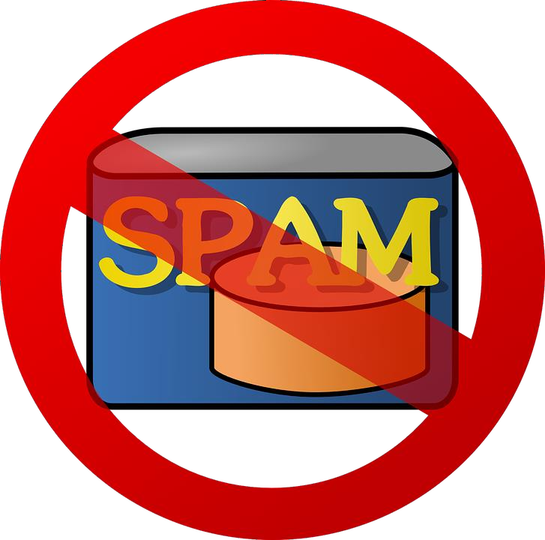
What about all the other words?
We can construct P(Spam | Word) for every (meaningful) word we encounter during training
Then multiply these together when analyzing a new email to get the probability of it being spam.
Assumes the presence of different words are independent of each other – one reason this is called “Naïve Bayes”.

Slide 89
Sounds like a lot of work.
Scikit-learn to the rescue!
The CountVectorizer lets us operate on lots of words at once, and MultinomialNB does all the heavy lifting on Naïve Bayes.
We’ll train it on known sets of spam and “ham” (non-spam) emails
▫ So this is supervised learning!
Let’s do this

Slide 90
K-Means Clustering

Slide 91
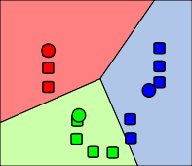
K-Means Clustering
Attempts to split data into K groups that are closest to K centroids
Unsupervised learning – uses only the positions of each data point
Can uncover interesting groupings of people
/ things / behavior
▫ Example: Where do millionaires live?
▫ What genres of music / movies / etc. naturally fall out of data?
▫ Create your own stereotypes from demographic data

Slide 92
K-Means Clustering
Sounds fancy! Wow! Unsupervised machine learning! Clusters! K!
Actually how it works is really simple.
▫ Randomly pick K centroids (k-means)
▫ Assign each data point to the centroid it’s closest to
▫ Recompute the centroids based on the average position of each centroid’s
points
▫ Iterate until points stop changing assignment to centroids
If you want to predict the cluster for new points, just find the centroid
they’re closest to.

Slide 93
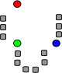
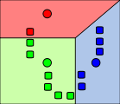
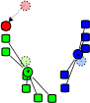
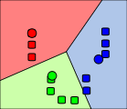
Graphical example
Images from Wikimedia Commons

Slide 94
K-Means Clustering Gotchas
Choosing K
▫ Try increasing K values until you stop getting large reductions in squared error (distances from each point to their centroids)
Avoiding local minima
▫ The random choice of initial centroids can yield different results
▫ Run it a few times just to make sure your initial results aren’t wacky
Labeling the clusters
▫ K-Means does not attempt to assign any meaning to the clusters you find
▫ It’s up to you to dig into the data and try to determine that

Slide 95
Let’s cluster stuff.
Again, scikit-learn makes this easy.

Slide 96
Entropy

Slide 97
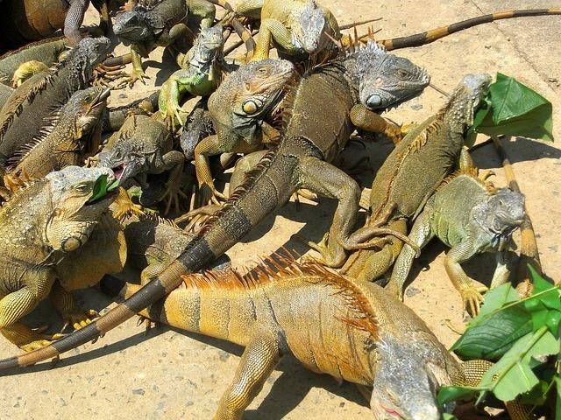
Entropy
A measure of a data set’s disorder – how same or different it is.
If we classify a data set into N different classes (example: a data set of animal attributes and their species)
▫ The entropy is 0 if all of the classes in the data are the same (everyone is an iguana)
▫ The entropy is high if they’re all different
Again, a fancy word for a simple concept.

Slide 98
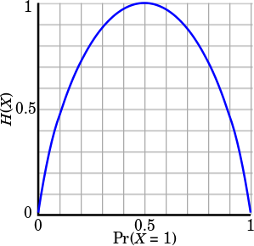
Computing entropy
𝐻 𝑆 = −𝑝₁ ln 𝑝₁ − ⋯ − 𝑝_{𝑛} ln 𝑝_{𝑛}
𝑝_{𝑖} represents the proportion of the data labeled for each class
Each term looks like this:

Slide 99
Decision Trees

Slide 100
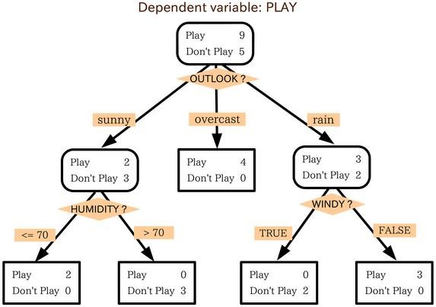
Decision Trees
You can actually construct a flowchart to help you decide a classification for something with machine learning
This is called a Decision Tree
Another form of supervised learning
▫ Give it some sample data and the resulting classifications
▫ Out comes a tree!

Slide 101
Decision Tree example
You want to build a system to filter out resumes based on historical hiring data
You have a database of some important attributes of job candidates,
and you know which ones were hired and which ones weren’t
You can train a decision tree on this data, and arrive at a system for predicting whether a candidate will get hired based on it!

Slide 102
Totally Fabricated Hiring Data
Candidate ID | Years Experience | Employed? | Previous employers | Level of Education | Top-tier school | Interned | Hired
0 | 10 | 1 | 4 | 0 | 0 | 0 | 1
1 | 0 | 0 | 0 | 0 | 1 | 1 | 1
2 | 7 | 0 | 6 | 0 | 0 | 0 | 0
3 | 2 | 1 | 1 | 1 | 1 | 0 | 1
4 | 20 | 0 | 2 | 2 | 1 | 0 | 0

Slide 103
Totally Fabricated Should-I-Hire-This-Person Tree
Did an internship?
No Yes
Currently employed?
Hire!
No Yes
Less than one prior employer?
Hire!
No Yes
Attended a top-tier
school?
Don’t Hire!
Don’t Hire!
No Yes
Hire!

Slide 104
How Decision Trees Work
At each step, find the attribute we can use to partition the data set to minimize the entropy of the data at the next step
Fancy term for this simple algorithm: ID3
It is a greedy algorithm – as it goes down the tree, it just picks the decision that reduce entropy the most at that stage.
▫ That might not actually result in an optimal tree.
▫ But it works.

Slide 105
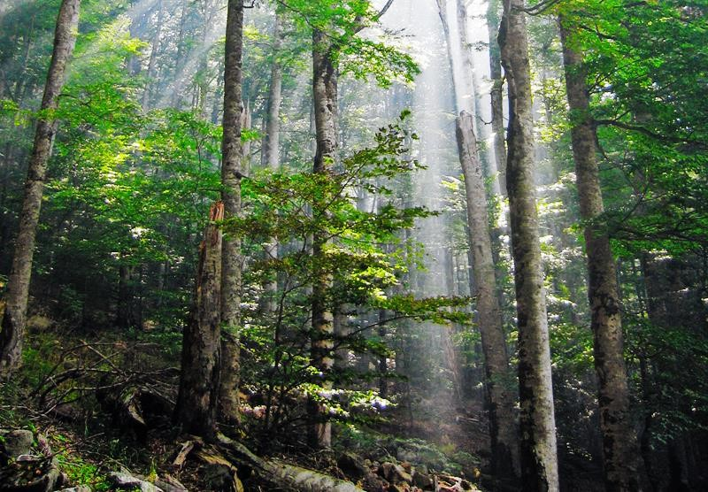
Random Forests
Decision trees are very susceptible to overfitting
To fight this, we can construct several
alternate decision trees and let them “vote”
on the final classification
▫ Randomly re-sample the input data for each tree (fancy term for this: bootstrap aggregating or bagging)
▫ Randomize a subset of the attributes each step is allowed to choose from

Slide 106
Let’s go make some trees.
Yet again, scikit-learn is awesome for this.

Slide 107
Ensemble Learning

Slide 108

Ensemble Learning
Random Forests was an example of ensemble learning
It just means we use multiple models to try and solve the same problem, and let them vote on the results.

Slide 109
Ensemble Learning
Random Forests uses bagging (bootstrap aggregating) to implement ensemble learning
▫ Many models are built by training on randomly-drawn subsets of the data
Boosting is an alternate technique where each subsequent model in the ensemble boosts attributes that address data mis-classified by the previous model
A bucket of models trains several different models using training data, and picks the one that works best with the test data
Stacking runs multiple models at once on the data, and combines the results together
▫ This is how the Netflix prize was won!

Slide 110
Advanced Ensemble Learning: Ways to Sound Smart
Bayes Optimal Classifier
▫ Theoretically the best – but almost always impractical
Bayesian Parameter Averaging
▫ Attempts to make BOC practical – but it’s still misunderstood, susceptible
to overfitting, and often outperformed by the simpler bagging approach
Bayesian Model Combination
▫ Tries to address all of those problems
▫ But in the end, it’s about the same as using cross-validation to find the best combination of models

Slide 111
XGBoost

Slide 112
XGBoost
booster[0]:
0:[f2<2.3499999] yes=1,no=2,missing=1
1:leaf=0.425454557
2:leaf=-0.218918934
booster[1]:
0:[f2<2.3499999] yes=1,no=2,missing=1
1:leaf=-0.212727293
2:[f3<1.75] yes=3,no=4,missing=3
3:[f2<4.94999981] yes=5,no=6,missing=5
5:leaf=0.404698014
6:leaf=0.0310344752
4:[f2<4.94999981] yes=7,no=8,missing=7
7:leaf=-0.0360000096
8:leaf=-0.212101951
booster[2]:
0:[f3<1.6500001] yes=1,no=2,missing=1
1:[f2<4.94999981] yes=3,no=4,missing=3
3:leaf=-0.218272462
4:leaf=0.179999992
2:[f2<4.85000038] yes=5,no=6,missing=5
5:leaf=0.128571421
6:leaf=0.410059184
booster[3]:
0:[f2<2.3499999] yes=1,no=2,missing=1
1:leaf=0.293001503
2:leaf=-0.195878834
booster[4]:
0:[f2<2.3499999] yes=1,no=2,missing=1
1:leaf=-0.189249262
2:[f3<1.75] yes=3,no=4,missing=3
3:[f2<4.94999981] yes=5,no=6,missing=5
5:leaf=0.278669834
6:leaf=0.0307718068
4:[f2<4.94999981] yes=7,no=8,missing=7
7:leaf=-0.0279411841
8:leaf=-0.189206496
eXtreme Gradient Boosted trees
Remember boosting is an ensemble method
▫ Each tree boosts attributes that led to mis- classifications of previous tree
It is AMAZING
▫ Routinely wins Kaggle competitions
▫ Easy to use
▫ Fast
▫ A good choice for an algorithm to start with

Slide 113

Features of XGBoost
Regularized boosting (prevents overfitting)
Can handle missing values automatically
Parallel processing
Can cross-validate at each iteration
▫ Enables early stopping, finding optimal number of iterations
Incremental training
Can plug in your own optimization objectives
Tree pruning
▫ Generally results in deeper, but optimized, trees

Slide 114
Using XGBoost
Pip install xgboost
Also CLI, C++, R, Julia, JVM interfaces
It’s not just made for scikit_learn, so it has its own interface
▫ Uses DMatrix structure to hold features & labels
🞄 Can create this easily from a numpy array though
▫ All parameters passed in via a dictionary
Call train, then predict. It’s easy.

Slide 115
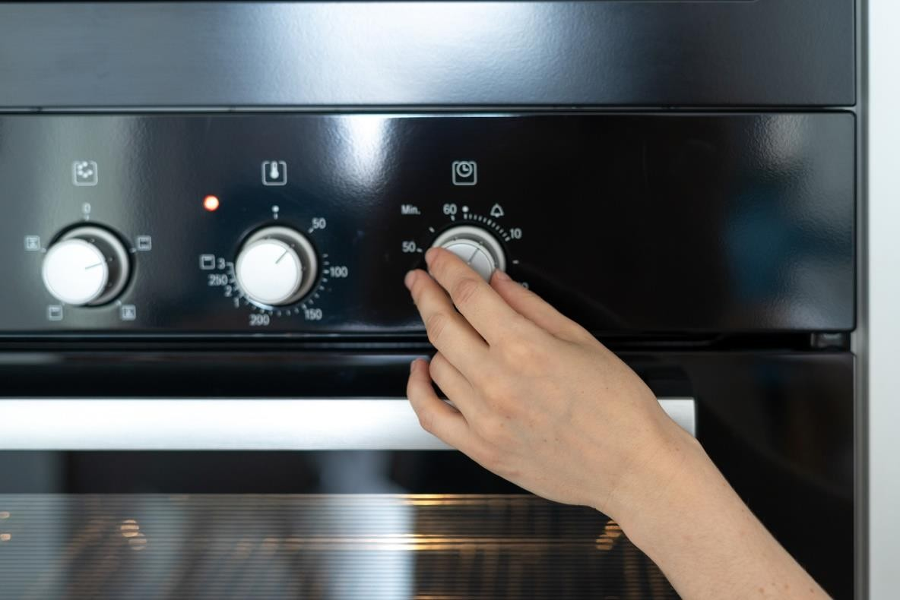
XGBoost Hyperparameters
Booster
▫ gbtree or gblinear
Objective (ie, multi:softmax, multi:softprob)
Eta (learning rate – adjusts weights on each step)
Max_depth (depth of the tree)
Min_child_weight
▫ Can control overfitting, but too high will underfit
…and many others

Slide 116

XGBoost
It’s almost all that you need to know for ML in practical terms, at least for simple classification or regression problems.
Let’s see it in action.

Slide 117
Support Vector Machines

Slide 118
Support Vector Machines
Works well for classifying higher-dimensional data (lots of features)
Finds higher-dimensional support vectors across which to divide the data (mathematically, these support vectors define hyperplanes.
Needless to say I’m not going to get into the mathematical details!)
Uses something called the kernel trick to represent data in higher- dimensional spaces to find hyperplanes that might not be apparent in lower dimensions

Slide 119
Higher dimensions? Hyperplanes? Huh?
The important point is that SVM’s employ some advanced mathematical
trickery to cluster data, and it can handle data sets with lots of features.
It’s also fairly expensive – the “kernel trick” is the only thing that makes
it possible.

Slide 120
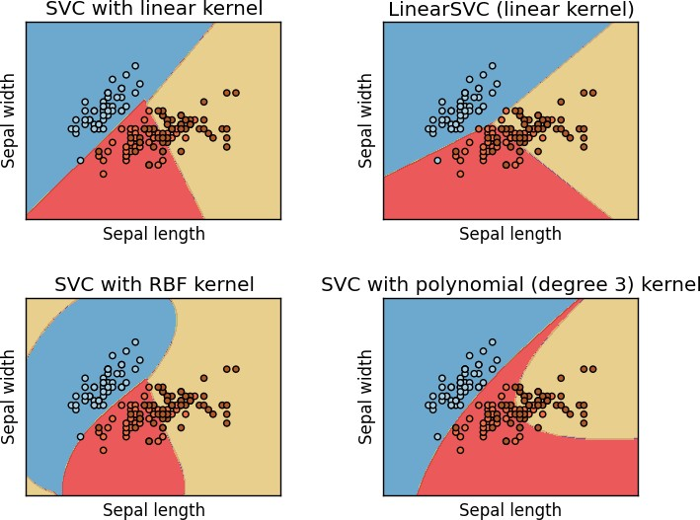
Support Vector Classification
In practice you’ll use something called SVC to classify data using SVM.
You can use different “kernels” with SVC. Some will work better than others for a given data set.

Slide 121
Let’s play with SVC’s
Don’t even try to do this without scikit-learn.

Slide 122
Recommender Systems

Slide 123

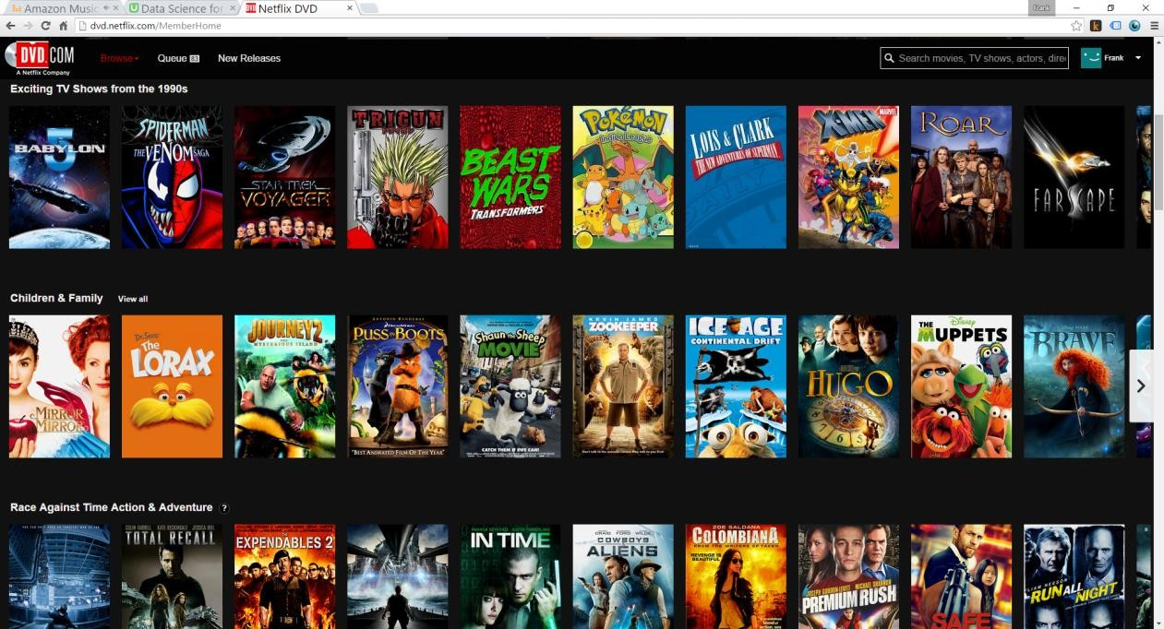
What are recommender systems?

Slide 124
User-Based Collaborative Filtering
Build a matrix of things each user bought/viewed/rated
Compute similarity scores between users
Find users similar to you
Recommend stuff they bought/viewed/rated that you haven’t yet.

Slide 125




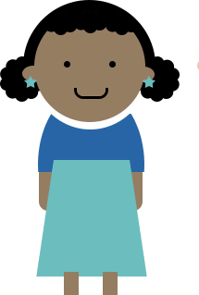

User-Based Collaborative Filtering

Slide 126
User-Based Collaborative Filtering

Slide 127
Problems with User-Based CF
People are fickle; tastes change
There are usually many more people than things
People do bad things

Slide 128
What if we based recommendations on relationships between things instead of people?
A movie will always be the same movie – it doesn’t change
There are usually fewer things than people (less computation to do)
Harder to game the system

Slide 129
Item-Based Collaborative Filtering
Find every pair of movies that were watched by the same person
Measure the similarity of their ratings across all users who watched both
Sort by movie, then by similarity strength
(This is just one way to do it!)

Slide 130

Item-Based Collaborative Filtering

Slide 131
Item-Based Collaborative Filtering

Slide 132
Item-Based Collaborative Filtering

Slide 133
Item-Based Collaborative Filtering

Slide 134
Let’s Do This
Next, we’ll use Python to create real “movie similarities” using the real
MovieLens data set.
▫ In addition to being important for item-based collaborative filtering, these results are valuable in themselves – think “people who liked X also liked Y”
It’s real world data, and we’ll encounter real world problems
Then we’ll use those results to create movie recommendations for
individuals

Slide 135
K-Nearest Neighbor

Slide 136
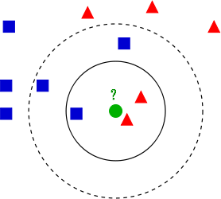
K-Nearest Neighbor (KNN)
Used to classify new data points based on “distance” to known data
Find the K nearest neighbors, based on your distance metric
Let them all vote on the classification
That’s it!

Slide 137
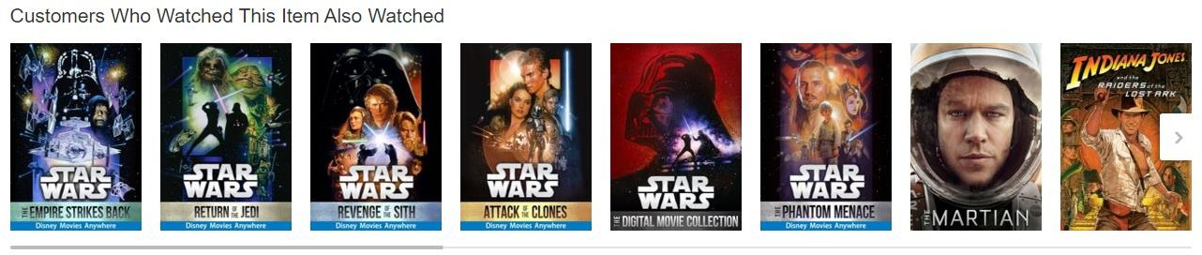
It’s Really That Simple
Although it’s one of the simplest machine learning models there is – it
still qualifies as “supervised learning”.
But let’s do something more complex with it
Movie similarities just based on metadata!

Slide 138
Discrete Choice Models

Slide 139
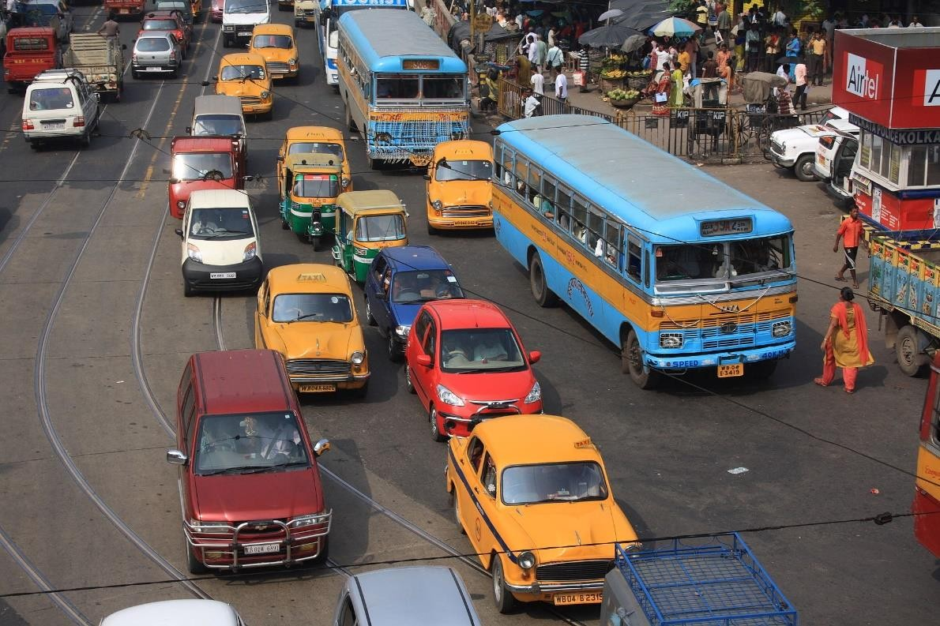
Discrete Choice Models
Predict some choice people have between discrete alternatives
▫ Do I take the train, bus, or car to work today? (Multinomial choice)
▫ Which college will I go to? (Multinomial)
▫ Will I cheat on my spouse? (Binary)
The alternatives must be finite, exhaustive, and mutually exclusive

Slide 140
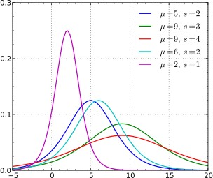
Discrete Choice Models
Use some sort of regression on the relevant attributes
▫ Attributes of the people
▫ Variables of the alternatives
Generally uses Logit or Probit models
▫ Logistic Regression, Probit Model
▫ Based on some utility function you define
▫ Similar – one uses logistic distribution, Probit uses normal distribution. Logistic looks a lot like normal, but with fatter tails (higher kurtosis)

Slide 141
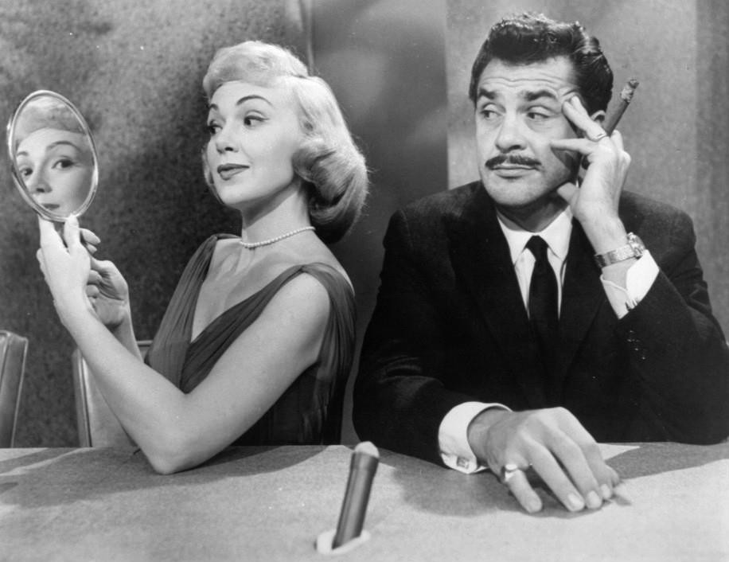
Example
Will my spouse cheat on me?

Slide 142
The Curse of Dimensionality
Principal Component Analysis

Slide 143
What is the curse of dimensionality?
Many problems can be thought of as having a huge number of
“dimesions”
For example, in recommending movies, the ratings vector for each movie may represent a dimension – every movie is its own dimension!
That makes your head hurt. It’s tough to visualize.
Dimensionality reduction attempts to distill higher-dimensional data down to a smaller number of dimensions, while preserving as much of the variance in the data as possible.

Slide 144
Remember K-Means Clustering?
This is an example of a dimensionality reduction algorithm.
It reduces data down to K dimensions.

Slide 145
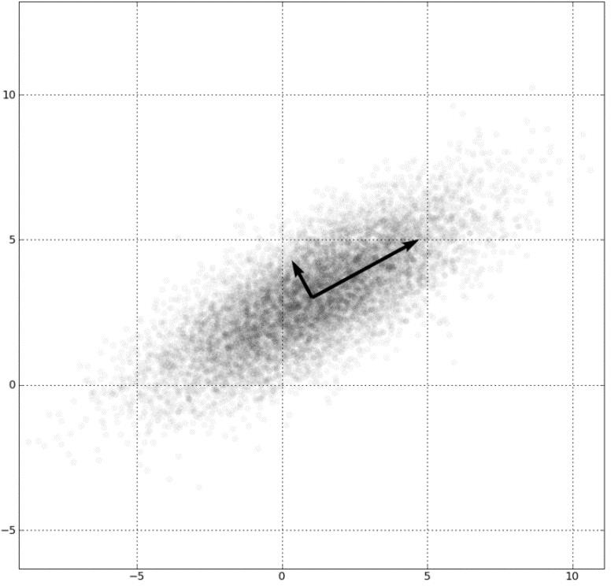
Another way: Principal Component Analysis (PCA)
Involves fancy math – but at a high level:
Finds “eigenvectors” in the higher dimensional data
▫ These define hyperplanes that split the data while
preserving the most variance in it
▫ The data gets projected onto these hyperplanes, which represent the lower dimensions you want to represent
▫ A popular implementation of this is called Singular Value
Decomposition (SVD)
Also really useful for things like image compression and facial recognition

Slide 146

Example: Visualizing 4-D Iris Flower Data
The “Iris dataset” comes with scikit-learn
An Iris flower has petals and sepals (the lower, supportive part of the flower.)
We know the length and width of the petals and sepals for many Iris specimens
▫ That’s four dimensions! Ow.
▫ We also know the subspecies classification of each flower
PCA lets us visualize this in 2 dimensions instead of 4, while still preserving variance.

Slide 147
Example: Visualizing 4-D Iris Flower Data
Yet again, scikit-learn makes this complex technique really easy.

Slide 148
ETL and ELT
Data Warehousing Introduction

Slide 149
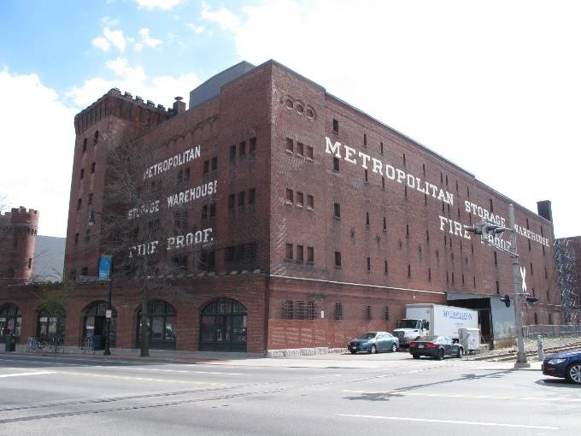
What is Data Warehousing?
A large, centralized database that contains information from many sources
Often used for business analysis in large corporations or organizations
Queried via SQL or tools (i.e. Tableau)
Often entire departments are dedicated to maintaining a data warehouse
▫ Data normalization is tricky – how does all of this data relate to each other? What views do people need?
▫ Maintaining the data feeds is a lot of work
▫ Scaling is tricky

Slide 150
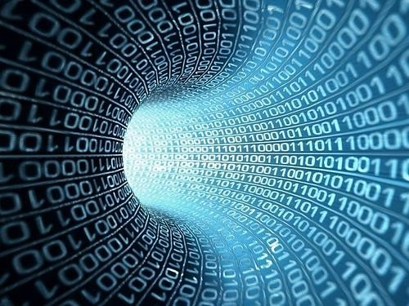
ETL: Extract, Transform, Load
ETL and ELT refer to how data gets into a data warehouse.
Traditionally, the flow was Extract, Transform, Load:
▫ Raw data from operational systems is first periodically
extracted
▫ Then, the data is transformed into the schema needed by the DW
▫ Finally, the data is loaded into the data warehouse, already in
the structure needed
But what if we’re dealing with “big data”? That transform
step can turn into a big problem.

Slide 151

ELT: Extract, Load, Transform
Today, a huge Oracle instance isn’t the only choice for a large
data warehouse
Things like Hive let you host massive databases on a Hadoop cluster
Or, you might store it in a large, distributed NoSQL data store
▫ …and query it using things like Spark or MapReduce
The scalability of Hadoop lets you flip the loading process on its head
▫ Extract raw data as before
▫ Load it in as-is
▫ Then use the power of Hadoop to transform it in-place

Slide 152

Lots more to explore
Data warehousing is a discipline in itself, too big too cover here
Check out other courses on Big Data, Spark, and MapReduce
▫ We will cover Spark in more depth later in this course.

Slide 153
Reinforcement Learning

Slide 154
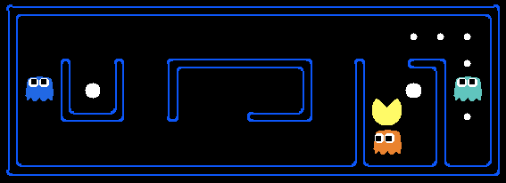
Reinforcement Learning
You have some sort of agent that “explores” some space
As it goes, it learns the value of different state changes in different conditions
Those values inform subsequent behavior of the agent
Examples: Pac-Man, Cat & Mouse game
Yields fast on-line performance once the space has been explored

Slide 155
Q-Learning
A specific implementation of reinforcement learning
You have:
▫ A set of environmental states s
▫ A set of possible actions in those states a
▫ A value of each state/action Q
Start off with Q values of 0
Explore the space
As bad things happen after a given state/action, reduce its Q
As rewards happen after a given state/action, increase its Q

Slide 156
Q-Learning
Q(s, a) += alpha * (reward(s,a) + max(Q(s') - Q(s,a)) where s is the previous state, a is the previous action,s' is the current state, and alpha is the discount factor (set to .5 here).
What are some state/actions here?
▫ Pac-man has a wall to the West
▫ Pac-man dies if he moves one step South
▫ Pac-man just continues to live if going North or East
You can “look ahead” more than one step by using a discount factor when computing Q (here s is previous state, s’ is current state)
▫ Q(s,a) += discount * (reward(s,a) + max(Q(s’)) – Q(s,a))

Slide 157
The exploration problem
How do we efficiently explore all of the possible states?
▫ Simple approach: always choose the action for a given state with the
highest Q. If there’s a tie, choose at random
🞄 But that’s really inefficient, and you might miss a lot of paths that way
▫ Better way: introduce an epsilon term
🞄 If a random number is less than epsilon, don’t follow the highest Q, but choose
at random
🞄 That way, exploration never totally stops
🞄 Choosing epsilon can be tricky

Slide 158
Fancy Words
Markov Decision Process
▫ From Wikipedia: Markov decision processes (MDPs) provide a mathematical framework for modeling decision making in situations where outcomes are partly random and partly under the control of a decision maker.
▫ Sound familiar? MDP’s are just a way to describe what we just did using
mathematical notation.
▫ States are still described as s and s’
▫ State transition functions are described as 𝑃_{𝑎} 𝑠, 𝑠′
▫ Our “Q” values are described as a reward function 𝑅_{𝑎} 𝑠, 𝑠′
Even fancier words! An MDP is a discrete time stochastic control process.

Slide 159
More Fancy Words
Dynamic Programming
▫ From Wikipedia: dynamic programming is a method for solving a complex problem by breaking it down into a collection of simpler subproblems, solving each of those subproblems just once, and storing their solutions - ideally, using a memory-based data structure. The next time the same subproblem occurs, instead of recomputing its solution, one simply looks up the previously computed solution, thereby saving computation time at the expense of a (hopefully) modest expenditure in storage space.
▫ Sound familiar?

Slide 160

So to recap
You can make an intelligent Pac-Man in a few steps:
▫ Have it semi-randomly explore different choices of movement (actions) given different conditions (states)
▫ Keep track of the reward or penalty associated with each choice for a given state/action (Q)
▫ Use those stored Q values to inform its future choices
Pretty simple concept. But hey, now you can say you understand reinforcement learning, Q-learning, Markov Decision Processes, and Dynamic Programming!

Slide 161
Implementing Reinforcement Learning
Python Markov Decision Process Toolbox:
▫ http://pymdptoolbox.readthedocs.org/en/latest/api/mdp.html
Cat & Mouse Example:
▫ https://github.com/studywolf/blog/tree/master/RL/Cat%20vs%20Mouse% 20exploration
Pac-Man Example:
▫ https://inst.eecs.berkeley.edu/~cs188/sp12/projects/reinforcement/reinfor cement.html

Slide 162
Confusion Matrix

Slide 163

Sometimes accuracy doesn’t tell the whole story
A test for a rare disease can be 99.9% accurate by just guessing “no” all the time
We need to understand true positives and true negative, as well as false positives and false negatives.
A confusion matrix shows this.

Slide 164
Binary confusion matrix
 | Actual YES | Actual NO
Predicted YES | TRUE POSITIVES | FALSE POSITIVES
Predicted NO | FALSE NEGATIVES | TRUE NEGATIVE

Slide 165

Image has cat?
 | Actual cat | Actual not cat
Predicted cat | 50 | 5
Predicted not cat | 10 | 100

Slide 166
Another format
 | Predicted NO | Predicted YES
Actual NO | 50 | 5 | 55
Actual YES | 10 | 100 | 110
 | 60 | 105

Slide 167

Multi-class confusion matrix + heat map

Slide 168
Measuring your Models

Slide 169
Remember our friend the confusion matrix
 | Actual YES | Actual NO
Predicted YES | TRUE POSITIVES | FALSE POSITIVES
Predicted NO | FALSE NEGATIVES | TRUE NEGATIVE

Slide 170
Recall
𝑇𝑅𝑈𝐸 𝑃𝑂𝑆𝐼𝑇𝐼𝑉𝐸𝑆
•
𝑇𝑅𝑈𝐸 𝑃𝑂𝑆𝐼𝑇𝐼𝑉𝐸𝑆+𝐹𝐴𝐿𝑆𝐸 𝑁𝐸𝐺𝐴𝑇𝐼𝑉𝐸𝑆
AKA Sensitivity, True Positive rate, Completeness
Percent of positives correctly predicted
Good choice of metric when you care a lot about false negatives
▫ i.e., fraud detection

Slide 171
Recall example
 | Actual fraud | Actual not fraud
Predicted fraud | 5 | 20
Predicted not fraud | 10 | 100
Recall = TP/(TP+FN)
Recall = 5/(5+10) = 5/15 = 1/3 = 33%

Slide 172
Precision
𝑇𝑅𝑈𝐸 𝑃𝑂𝑆𝐼𝑇𝐼𝑉𝐸𝑆
•
𝑇𝑅𝑈𝐸 𝑃𝑂𝑆𝐼𝑇𝐼𝑉𝐸𝑆+𝐹𝐴𝐿𝑆𝐸 𝑃𝑂𝑆𝐼𝑇𝐼𝑉𝐸𝑆
AKA Correct Positives
Percent of relevant results
Good choice of metric when you care a lot about false positives
▫ i.e., medical screening, drug testing

Slide 173
Precision example
 | Actual fraud | Actual not fraud
Predicted fraud | 5 | 20
Predicted not fraud | 10 | 100
Precision = TP/(TP+FP)
Precision = 5/(5+20) = 5/25 = 1/5 = 20%

Slide 174
Other metrics
Specificity =
F1 Score
𝑇𝑁
= “True negative rate”
𝑇𝑁+𝐹𝑃
▫
2𝑇𝑃
2𝑇𝑃+𝐹𝑃+𝐹𝑁
_{2 ∙} 𝑃𝑟𝑒𝑐𝑖𝑠𝑖𝑜𝑛∙𝑅𝑒𝑐𝑎𝑙𝑙
▫
𝑃𝑟𝑒𝑐𝑖𝑠𝑖𝑜𝑛+𝑅𝑒𝑐𝑎𝑙𝑙
▫ Harmonic mean of precision and sensitivity
▫ When you care about precision AND recall
RMSE
▫ Root mean squared error, exactly what it sounds like
▫ Accuracy measurement
▫ Only cares about right & wrong answers

Slide 175

ROC Curve
Receiver Operating Characteristic Curve
Plot of true positive rate (recall) vs. false positive rate at various threshold settings.
Points above the diagonal represent good classification (better than random)
Ideal curve would just be a point in the upper-left corner
BOR at the English language Wikipedia [CC BY-SA 3.0 (http://creativecommons.org/licenses/by-sa/3.0/)]
The more it’s “bent” toward the upper-left, the better

Slide 176
AUC
The area under the ROC curve is… wait for it..
Area Under the Curve (AUC)
Equal to probability that a classifier will rank a randomly chosen positive instance higher than a randomly chosen negative one
ROC AUC of 0.5 is a useless classifier, 1.0 is perfect
Commonly used metric for comparing classifiers

Slide 177
The Bias / Variance Tradeoff

Slide 178

Bias and Variance
Bias is how far removed the mean of your predicted values is from the “real” answer
Variance is how scattered your predicted values are from the “real” answer
Describe the bias and variance of these four cases (assuming the center is the correct result)

Slide 179


Often you need to choose between bias and variance
It comes down to overfitting vs underfitting your data

Slide 180
But what you really care about is error
Bias and variance both contribute to error
▫ 𝐸𝑟𝑟𝑜𝑟 = 𝐵𝑖𝑎𝑠² + 𝑉𝑎𝑟𝑖𝑎𝑛𝑐𝑒
But it’s error you want to minimize, not bias or variance specifically
A complex model will have high variance and low bias
A too-simple model will have low variance and high bias
But both may have the same error – the optimal complexity is in the middle

Slide 181
Tying it to earlier lessons
Increasing K in K-Nearest-Neighbors decreases variance and increases bias (by averaging together more neighbors)
A single decision tree is prone to overfitting – high variance
▫ But a random forest decreases that variance.

Slide 182
Avoiding Overfitting
Using K-Fold Cross Validation

Slide 183
Review: K-Fold Cross Validation
One way to further protect against overfitting is K-fold cross validation
Sounds complicated. But it’s a simple idea:
▫ Split your data into K randomly-assigned segments
▫ Reserve one segment as your test data
▫ Train on the combined remaining K-1 segments and measure their performance against the test set
▫ Repeat for each segment
▫ Take the average of the K r-squared scores
Prevents you from overfitting to a single train/test split

Slide 184
Using K-Fold Cross Validation
Scikit-learn makes this really easy. Even easier than just a single train/test split.
In practice, you need to try different variations of your model and measure the mean accuracy using K-Fold Cross validation until you find a sweet spot

Slide 185
Let’s Play
Use K-Fold Cross Validation with a SVC model of Iris classification.
We’ll see that without K-Fold, we could overfit the model.

Slide 186
Cleaning Your Data

Slide 187

Cleaning your Data
The reality is, much of your time as a data
scientist will be spent preparing and “cleaning”
your data
▫ Outliers
▫ Missing Data
▫ Malicious Data
▫ Erroneous Data
▫ Irrelevant Data
▫ Inconsistent Data
▫ Formatting

Slide 188

Garbage In, Garbage Out
Look at your data! Examine it!
Question your results!
▫ And always do this – not just when you
don’t get a result that you like!

Slide 189

Let’s analyze some web log data.
All I want is the most-popular pages on my non-profit news website.
How hard can that be?

Slide 190
Normalizing Numerical Data

Slide 191
The importance of normalizing data
If your model is based on several numerical attributes – are they comparable?
▫ Example: ages may range from 0-100, and incomes from 0-billions
▫ Some models may not perform well when different attributes are on very different scales
▫ It can result in some attributes counting more than others
▫ Bias in the attributes can also be a problem.

Slide 192
Examples
Scikit-learn’s PCA implementation has a “whiten” option that does this
for you. Use it.
Scikit-learn has a preprocessing module with handy normalize and scale functions
Your data may have “yes” and “no” that needs to be converted to “1” and “0”

Slide 193
Read the docs
Most data mining and machine learning techniques work fine with raw, un-normalized data
But double check the one you’re using before you start.
Don’t forget to re-scale your results when you’re done!

Slide 194
Dealing with Outliers

Slide 195

Dealing with Outliers
Sometimes it’s appropriate to remove outliers from your
training data
Do this responsibly! Understand why you are doing this.
For example: in collaborative filtering, a single user who rates thousands of movies could have a big effect on everyone else’s ratings. That may not be desirable.
Another example: in web log data, outliers may represent bots or other agents that should be discarded.
But if someone really wants the mean income of US citizens for example, don’t toss out billionaires just because you want to.

Slide 196
Dealing with Outliers
Our old friend standard deviation provides a principled way to classify outliers.
Find data points more than some multiple of a standard deviation in your training data.
What multiple? You just have to use common sense.

Slide 197
Let’s play with some data.

Slide 198
Feature Engineering

Slide 199
What is feature engineering?
Applying your knowledge of the data – and the model you’re using - to create better features to train your model with.
▫ Which features should I use?
▫ Do I need to transform these features in some way?
▫ How do I handle missing data?
▫ Should I create new features from the existing ones?
You can’t just throw in raw data and expect good results
This is the art of machine learning; where expertise is applied
“Applied machine learning is basically feature engineering” – Andrew Ng

Slide 200

The Curse of Dimensionality
Too many features can be a problem –
leads to sparse data
Every feature is a new dimension
Much of feature engineering is selecting the features most relevant to the problem at hand
▫ This often is where domain knowledge comes into play
Unsupervised dimensionality reduction techniques can also be employed to distill many features into fewer features
▫ PCA
▫ K-Means

Slide 201

Imputing Missing Data: Mean Replacement
Replace missing values with the mean value from the rest of the column (columns, not rows! A column represents a single feature; it only makes sense to take the mean from other samples of the same feature.)
Fast & easy, won’t affect mean or sample size of
overall data set
Median may be a better choice than mean when
outliers are present
But it’s generally pretty terrible.
▫ Only works on column level, misses correlations between features
▫ Can’t use on categorical features (imputing with most
frequent value can work in this case, though)
▫ Not very accurate

Slide 202

Imputing Missing Data: Dropping
If not many rows contain missing data…
▫ …and dropping those rows doesn’t bias your data…
▫ …and you don’t have a lot of time…
▫ …maybe it’s a reasonable thing to do.
But, it’s never going to be the right answer for the “best” approach.
Almost anything is better. Can you substitute another similar field perhaps? (i.e., review summary vs. full text)

Slide 203
Imputing Missing Data: Machine Learning
KNN: Find K “nearest” (most similar) rows and average their values
▫ Assumes numerical data, not categorical
▫ There are ways to handle categorical data (Hamming distance), but categorical
data is probably better served by…
Deep Learning
▫ Build a machine learning model to impute data for your machine learning model!
▫ Works well for categorical data. Really well. But it’s complicated.
Regression
▫ Find linear or non-linear relationships between the missing feature and other features
▫ Most advanced technique: MICE (Multiple Imputation by Chained Equations)

Slide 204
Imputing Missing Data: Just Get More Data
What’s better than imputing data? Getting more real data!
Sometimes you just have to try harder or collect more data

Slide 205
Handling Unbalanced Data

Slide 206

What is unbalanced data?
Large discrepancy between
“positive” and “negative” cases
▫ i.e., fraud detection. Fraud is rare,
and most rows will be not-fraud
▫ Don’t let the terminology confuse you; “positive” doesn’t mean “good”
🞄 It means the thing you’re testing for
is what happened.
🞄 If your machine learning model is made to detect fraud, then fraud is the positive case.
Mainly a problem with neural networks

Slide 207

Oversampling
Duplicate samples from the minority class
Can be done at random

Slide 208

Undersampling
Instead of creating more positive samples, remove negative ones
Throwing data away is usually not the right answer
▫ Unless you are specifically trying
to avoid “big data” scaling issues

Slide 209
SMOTE
Synthetic Minority Over-sampling TEchnique
Artificially generate new samples of the minority class using nearest neighbors
▫ Run K-nearest-neighbors of each sample of the minority class
▫ Create a new sample from the KNN result (mean of the neighbors)
Both generates new samples and undersamples majority class
Generally better than just oversampling

Slide 210

Adjusting thresholds
When making predictions about a classification (fraud / not fraud), you have some sort of threshold of probability at
which point you’ll flag something as the
positive case (fraud)
If you have too many false positives, one way to fix that is to simply increase that threshold.
▫ Guaranteed to reduce false positives
▫ But, could result in more false negatives

Slide 211

Binning
Bucket observations together based on ranges of values.
Example: estimated ages of people
▫ Put all 20-somethings in one classification, 30-somethings in another, etc.
Quantile binning categorizes data by their place in the data distribution
▫ Ensures even sizes of bins
Transforms numeric data to ordinal data
Especially useful when there is uncertainty in the measurements

Slide 212

Transforming
Feature data with an exponential trend may benefit from a logarithmic transform
Applying some function to a feature to make it better suited for training
Example: YouTube recommendations
A numeric feature 𝑥 is also represented by
𝑥²and 𝑥
This allows learning of super and sub-linear functions
(ref: https://static.googleusercontent.com/media/research.google.com/en//pubs/archive/45530.pdf)
Image: By Autopilot - Own work, CC BY-SA 3.0, https://commons.wikimedia.org/w/index.php?curid=10733854

Slide 213

Encoding
Transforming data into some new representation required by the model
One-hot encoding
▫ Create “buckets” for every category
▫ The bucket for your category has a 1, all others have a 0
▫ Very common in deep learning, where categories are represented by
individual output “neurons”
0 | 0 | 0 | 0 | 0 | 0 | 0 | 0 | 1 | 0

Slide 214

Scaling / Normalization
Some models prefer feature data to be normally distributed around 0 (most neural nets)
Most models require feature data to at least be scaled to comparable values
▫ Otherwise features with larger magnitudes will have more weight than they should
▫ Example: modeling age and income as features – incomes will be much higher values than ages
Scikit_learn has a preprocessor module that helps (MinMaxScaler, etc)
Remember to scale your results back up
Geek3 [CC BY 3.0 (https://creativecommons.org/licenses/by/3.0)]

Slide 215

Shuffling
Many algorithms benefit from shuffling their training data
Otherwise they may learn from residual signals in the training data resulting from the order in which they were collected

Slide 216
Installing Apache Spark on Windows

Slide 217

Installing Spark on Windows
Install a JDK
Install Python (but you should already have this)
Install a pre-built version of Spark for Hadoop
Create a conf/log4j.properties file to change the warning level
Add a SPARK_HOME environment variable
Add %SPARK_HOME%\bin to your PATH
Set HADOOP_HOME to c:\winutils
Install winutils.exe to c:\winutils\bin

Slide 218
Installing Spark on other OS’s
Pretty much the same, but look up how to set environment variables on your OS
Winutils.exe not needed of course

Slide 219
Let’s Do It

Slide 220
Spark Introduction

Slide 221

What is Spark?
"A fast and general engine for large-scale data processing"

Slide 222

It’s Scalable
Executor
- Cache
-Tasks
Driver Program
-Spark Context
Executor
- Cache
-Tasks
Cluster Manager
(Spark, YARN)
Executor
- Cache
-Tasks
...

Slide 223
It’s Fast
"Run programs up to 100x faster than Hadoop MapReduce in memory, or 10x faster on disk."
DAG Engine (directed acyclic graph) optimizes workflows

Slide 224
It’s Hot
Amazon
Ebay: log analysis and aggregation
NASA JPL: Deep Space Network
Groupon
TripAdviser
Yahoo
Many others: https://cwiki.apache.org/confluence/display/SPARK/Power ed+By+Spark

Slide 225
It’s Not That Hard
Code in Python, Java, or Scala
Built around one main concept: the Resilient Distributed Dataset (RDD)

Slide 226
Components of Spark
Spark Streaming
Spark SQL
MLLib
GraphX
SPARK CORE

Slide 227
Python vs. Scala
Why Python?
▫ No need to compile, manage dependencies, etc.
▫ Less coding overhead
▫ You already know Python
▫ Lets us focus on the concepts instead of a new language
But...
▫ Scala is probably a more popular choice with Spark.
▫ Spark is built in Scala, so coding in Scala is "native" to Spark
▫ New features, libraries tend to be Scala-first.

Slide 228
Fear Not
Python and Scala look very similar in Spark.
Python code to square numbers in a data set:
nums = sc.parallelize([1, 2, 3, 4])
squared = nums.map(lambda x: x * x).collect()
Scala code to square numbers in a data set:
val nums = sc.parallelize(List(1, 2, 3, 4))
val squared = nums.map(x => x * x).collect()

Slide 229
Resilient Distributed Datasets (RDDs)

Slide 230
RDD
Resilient
Distributed
Dataset

Slide 231
The SparkContext
Created by your driver program
Is responsible for making RDD's resilient and distributed!
Creates RDD's
The Spark shell creates a "sc" object for you

Slide 232
Creating RDD’s
nums = parallelize([1, 2, 3, 4])
sc.textFile("file:///c:/users/frank/gobs-o-text.txt")
▫ or s3n:// , hdfs://
hiveCtx = HiveContext(sc) users")
Can also create from:
rows = hiveCtx.sql("SELECT name, age FROM
▫ JDBC
▫ Cassandra
▫ HBase
▫ Elastisearch
▫ JSON, CSV, sequence files, object files, various compressed formats

Slide 233
Transforming RDD’s
map
flatmap
filter
distinct
sample
union, intersection, subtract, cartesian

Slide 234
Map() example
rdd = sc.parallelize([1, 2, 3, 4])
rdd.map(lambda x: x*x)
This yields 1, 4, 9, 16

Slide 235
What’s that lambda thing?
Many RDD methods accept a function as a parameter
rdd.map(lambda x: x*x)
Is the same thing as
def squareIt(x):
return x*x
rdd.map(squareIt)
There, you now understand functional programming.

Slide 236
RDD Actions
collect
count
countByValue
take
top
reduce
… and more ...

Slide 237
Lazy Evaluation
Nothing actually happens in your driver program until an action is called!

Slide 238
Introducing MLLib

Slide 239
Some MLLib Capabilities
Feature extraction
▫ Term Frequency / Inverse Document Frequency useful for search
Basic statistics
▫ Chi-squared test, Pearson or Spearman correlation, min, max, mean, variance
Linear regression, logistic regression
Support Vector Machines
Naïve Bayes classifier
Decision trees
K-Means clustering
Principal component analysis, singular value decomposition
Recommendations using Alternating Least Squares

Slide 240
Special MLLib Data Types
Vector (dense or sparse)
LabeledPoint
Rating

Slide 241
TF-IDF

Slide 242

TF-IDF
Stands for Term Frequency and Inverse Document Frequency
Important data for search – figures out what terms are most relevant for a document
Sounds fancy!

Slide 243
TF-IDF Explained
Term Frequency just measures how often a word occurs in a document
▫ A word that occurs frequently is probably important to that document’s
meaning
Document Frequency is how often a word occurs in an entire set of documents, i.e., all of Wikipedia or every web page
▫ This tells us about common words that just appear everywhere no matter
what the topic, like “a”, “the”, “and”, etc.

Slide 244
TF-IDF Explained
So a measure of the relevancy of a word to a document might be:
𝑇𝑒𝑟𝑚 𝐹𝑟𝑒𝑞𝑢𝑒𝑛𝑐𝑦
𝐷𝑜𝑐𝑢𝑚𝑒𝑛𝑡 𝐹𝑟𝑒𝑞𝑢𝑒𝑛𝑐𝑦
Or: Term Frequency * Inverse Document Frequency
That is, take how often the word appears in a document, over how often it just appears everywhere. That gives you a measure of how important and unique this word is for this document

Slide 245
TF-IDF In Practice
We actually use the log of the IDF, since word frequencies are distributed exponentially. That gives us a better weighting of a words overall popularity
TF-IDF assumes a document is just a “bag of words”
▫ Parsing documents into a bag of words can be most of the work
▫ Words can be represented as a hash value (number) for efficiency
▫ What about synonyms? Various tenses? Abbreviations? Capitalizations?
Misspellings?
Doing this at scale is the hard part
▫ That’s where Spark comes in!

Slide 246
Using TF-IDF
A very simple search algorithm could be:
▫ Compute TF-IDF for every word in a corpus
▫ For a given search word, sort the documents by their TF-IDF score for that word
▫ Display the results

Slide 247

Let’s use TF-IDF on Wikipedia

Slide 248
Deploying models for real-time use

Slide 249
How do I use my model in an app?
Your external apps can’t just run a notebook!
Separate your training from your predictions
▫ Train the model periodically offline
▫ Push the model – or its results – to a web service
▫ Your app calls the web service

Slide 250
Example: Google Cloud ML
Dump your trained classifier using sklearn.externals
▫ from sklearn.externals import joblib joblib.dump(clf, 'model.joblib')
Upload model.joblib to Google cloud storage, specifying the scikit-learn framework
Cloud ML Engine exposes a REST API that you can call to make predictions in real-time
Exported
classifier
Cloud Storage
Cloud ML
Engine
REST
Applications

Slide 251



Example: AWS (recommender system)
Server logs
Client app

Slide 252










Other approaches
Roll your own web service with Flask or another framework
▫ Then you have servers to provision and maintain :/
Go all-in with a platform
A

Slide 253
A/B Tests

Slide 254


What is an A/B test?
A controlled experiment, usually in the context of a website
You test the performance of some change to your website (the variant) and measure conversion relative to your unchanged site (the control.)

Slide 255
What sorts of things can you test?
Design changes
UI flow
Algorithmic changes
Pricing changes
You name it

Slide 256
How do you measure conversion
Ideally choose what you are trying to influence
▫ Order amounts
▫ Profit
▫ Ad clicks
▫ Order quantity
But attributing actions downstream from your change can be hard
▫ Especially if you’re running more than one experiment

Slide 257
Variance is your Enemy
Common mistake:
▫ Run a test for some small period of time that results in a few purchases to analyze
▫ You take the mean order amount from A and B, and declare victory or defeat
▫ But, there’s so much random variation in order amounts to begin with, that
your result was just based on chance.
▫ You then fool yourself into thinking some change to your website, which could actually be harmful, has made tons of money.

Slide 258
Variance is your Enemy
Sometimes you need to also look at conversion metrics with less variance
Order quantities vs. order dollar amounts, for example

Slide 259
T-Tests and P-Values

Slide 260
Determining significance
So, how do we know if a result is likely to be “real” as opposed to just
random variation?
T-tests and P-values

Slide 261
The T-Statistic
A measure of the difference between the two sets expressed in units of standard error
The size of the difference relative to the variance in the data
A high t value means there's probably a real difference between the two sets
Assumes a normal distribution of behavior
▫ This is a good assumption if you’re measuring revenue as conversion
▫ See also: Fisher’s exact test (for clickthrough rates), E-test (for transactions per user) and chi-squared test (for product quantities purchased)

Slide 262
The P-Value
Think of it as the probability of A and B satisfying the “null hypothesis”
So, a low P-Value implies significance.
It is the probability of an observation lying at an extreme t-value assuming the null hypothesis

Slide 263
Using P-values
Choose some threshold for “significance” before your experiment
▫ 1%? 5%?
When your experiment is over:
▫ Measure your P-value
▫ If it’s less than your significance threshold, then you can reject the null
hypothesis
🞄 If it’s a positive change, roll it out
🞄 If it’s a negative change, discard it before you lose more money.

Slide 264
Let’s work through an example.

Slide 265
How Long Do I Run an Experiment?

Slide 266
How do I know when I’m done with an A/B test?
You have achieved significance (positive or negative)
You no longer observe meaningful trends in your p-value
▫ That is, you don’t see any indication that your experiment will “converge”
on a result over time
You reach some pre-established upper bound on time

Slide 267
A/B Test Gotchas

Slide 268
Correlation does not imply causation
Even your low p-value score on a well-designed experiment does not imply causation!
▫ It could still be random chance
▫ Other factors could be at play
▫ It’s your duty to ensure business owners understand this

Slide 269
Novelty Effects
Changes to a website will catch the attention of previous users who are used to the way it used to be
▫ They might click on something simply because it is new
▫ But this attention won’t last forever
Good idea to re-run experiments much later and validate their impact
▫ Often the “old” website will outperform the “new” one after awhile, simply
because it is a change

Slide 270

Seasonal Effects
An experiment run over a short period of time may only be valid for that period of time
▫ Example: Consumer behavior near Christmas is very different than other times of year
▫ An experiment run near Christmas may not represent behavior during the rest of the year

Slide 271
Selection Bias
Sometimes your random selection of customers for A or B isn’t really
random
▫ For example: assignment is based somehow on customer ID
▫ But customers with low ID’s are better customers than ones with high ID’s
Run an A/A test periodically to check
Audit your segment assignment algorithms

Slide 272

Data Pollution
Are robots (both self-identified and malicious) affecting your experiment?
▫ Good reason to measure conversion based on something that requires spending real money
More generally, are outliers skewing the result?

Slide 273
Attribution Errors
Often there are errors in how conversion is attributed to an experiment
Using a widely used A/B test platform can help mitigate that risk
▫ If your is home-grown, it deserves auditing
Watch for “gray areas”
▫ Are you counting purchases toward an experiment within some given time- frame of exposure to it? Is that time too large?
▫ Could other changes downstream from the change you’re measuring affect
your results?
▫ Are you running multiple experiments at once?

Slide 274
deep learning pre- requisites

Slide 275




gradient descent

Slide 276
autodiff
Gradient descent requires knowledge of, well, the gradient from your cost function (MSE)
Mathematically we need the first partial derivatives of all the inputs
This is hard and inefficient if you just throw calculus at the problem
Reverse-mode autodiff to the rescue!
Optimized for many inputs + few outputs (like a neuron)
Computes all partial derivatives in # of outputs + 1 graph traversals
Still fundamentally a calculus trick – it’s complicated but it works
This is what Tensorflow uses

Slide 277


softmax
Used for classification
Given a score for each class
It produces a probability of each class
The class with the highest probability is the “answer” you get
x is a vector of input values theta is a vector of weights

Slide 278

in review
Gradient descent is an algorithm for minimizing error over multiple steps
Autodiff is a calculus trick for finding the gradients in gradient descent
Softmax is a function for choosing the most probable classification given several input values

Slide 279
introducing artificial neural networks

Slide 280

the biological inspiration
Neurons in your cerebral cortex are connected via axons
A neuron “fires” to the neurons it’s connected to, when enough of its input signals are activated.
Very simple at the individual neuron level – but layers of neurons connected in this way can yield learning behavior.
Billions of neurons, each with thousands of connections, yields a mind

Slide 281

cortical columns
Neurons in your cortex seem to be arranged into many stacks, or “columns” that process information in parallel
“mini-columns” of around 100 neurons are organized into larger “hyper- columns”. There are 100 million mini- columns in your cortex
This is coincidentally similar to how GPU’s work…
(credit: Marcel Oberlaender et al.)

Slide 282
the first artificial neurons
1943!!
C
An artificial neuron “fires” if more than N
input connections are active.
Depending on the number of connections from each input neuron, and whether a connection activates or suppresses a neuron, you can construct AND, OR, and NOT logical constructs this way.
A
B
This example would implement C = A OR B if the threshold is 2 inputs being active.

Slide 283
the linear threshold unit (ltu)
1957!
Adds weights to the inputs; output is given by a step function
Sum up the products of the inputs and their weights
Output 1 if sum is >= 0
Σ
Weight 1
Weight 2
Input 1
Input 2

Slide 284
the perceptron
A layer of LTU’s
A perceptron can learn by reinforcing weights that lead to correct behavior during training
This too has a biological basis (“cells that fire together, wire together”)
Σ
Σ
Σ
Bias Neuron (1.0)
Weight 1
Weight 2
Input 1
Input 2

Slide 285

multi-layer perceptrons
Σ
Σ
Σ
Addition of “hidden layers”
This is a Deep Neural Network
Training them is trickier – but we’ll talk about that.
Σ
Σ
Σ
Σ
Bias Neuron (1.0)
Weight 1
Weight 2
Input 1
Input 2

Slide 286

softmax
a modern deep neural network
Σ
Σ Σ
Replace step activation function with something better
Apply softmax to the output
Training using gradient descent
Bias Neuron (1.0)
Σ
Σ
Σ
Σ
Bias Neuron (1.0)
Weight 1
Weight 2
Input 1
Input 2

Slide 287
let’s play

Slide 288
deep learning

Slide 289

backpropagation
How do you train a MLP’s weights? How does it
learn?
Backpropagation… or more specifically:
Gradient Descent using reverse-mode autodiff!
For each training step:
Compute the output error
Compute how much each neuron in the previous hidden layer contributed
Back-propagate that error in a reverse pass
Tweak weights to reduce the error using gradient
descent

Slide 290

activation functions (aka rectifier)
Step functions don’t work with gradient
descent – there is no gradient!
Mathematically, they have no useful derivative.
Alternatives:
Logistic function
Hyperbolic tangent function
Exponential linear unit (ELU)
ReLU function (Rectified Linear Unit)
ReLU is common. Fast to compute and works well.
Also: “Leaky ReLU”, “Noisy ReLU”
ELU can sometimes lead to faster learning though.
ReLU function

Slide 291

optimization functions
There are faster (as in faster learning) optimizers than gradient descent
Momentum Optimization
Introduces a momentum term to the descent, so it slows down as things start to flatten and speeds up as the slope is steep
Nesterov Accelerated Gradient
A small tweak on momentum optimization – computes momentum based on the gradient slightly ahead of you,
not where you are
RMSProp
Adaptive learning rate to help point toward the minimum
Adam
Adaptive moment estimation – momentum + RMSProp combined
Popular choice today, easy to use

Slide 292

avoiding overfitting
With thousands of weights to tune, overfitting is a problem
Early stopping (when performance starts dropping)
Regularization terms added to cost function during training
Dropout – ignore say 50% of all neurons randomly at each training step
Works surprisingly well!
Forces your model to spread out its learning

Slide 293

tuning your topology
Trial & error is one way
Evaluate a smaller network with less neurons in the hidden layers
Evaluate a larger network with more layers
Try reducing the size of each layer as you progress –
form a funnel
More layers can yield faster learning
Or just use more layers and neurons than you need, and don’t care because you use early stopping.
Use “model zoos”

Slide 294
tensorflow

Slide 295
why tensorflow?
It’s not specifically for neural networks– it’s more generally an
architecture for executing a graph of numerical operations
Tensorflow can optimize the processing of that graph, and distribute its processing across a network
Sounds a lot like Apache Spark, eh?
It can also distribute work across GPU’s!
Can handle massive scale – it was made by Google
Runs on about anything
Highly efficient C++ code with easy to use Python API’s

Slide 296
tensorflow basics
Install with conda install tensorflow or conda install tensorflow-gpu
A tensor is just a fancy name for an array or matrix of values
To use Tensorflow, you:
Construct a graph to compute your tensors
Initialize your variables
Execute that graph – nothing actually happens until then
World’s simplest Tensorflow app:
import tensorflow as tf
a | = | tf.Variable(1, | name="a")
b | = | tf.Variable(2, | name="b")
f | = | a + b
tf.print(f)

Slide 297

softmax
creating a neural network with tensorflow
Mathematical insights:
All those interconnected arrows multiplying weights can be thought of as a big matrix multiplication
The bias term can just be added onto the result
of that matrix multiplication
So in Tensorflow, we can define a layer of a neural network as:
output =
tf.matmul(previous_layer, layer_weights) + layer_biases
By using Tensorflow directly we’re kinda doing this the “hard way.”
Σ
Σ Σ
Bias Neuro n (1.0)
Σ
Σ Σ Σ
Weight
1
Weight 2
Bias Neuron
(1.0)
Input 1
Input 2

Slide 298

creating a neural network with tensorflow
Load up our training and testing data
Construct a graph describing our neural network
Associate an optimizer (ie gradient descent) to the network
Run the optimizer with your training data
Evaluate your trained network with your testing data

Slide 299
make sure your features are normalized
Neural networks usually work best if your input data is normalized.
That is, 0 mean and unit variance
The real goal is that every input feature is comparable in terms of magnitude
scikit_learn’s StandardScaler can do this for you
Many data sets are normalized to begin with – such as the one we’re
about to use.

Slide 300
keras

Slide 301

why keras?
Easy and fast prototyping
Runs on top of TensorFlow (or CNTK, or Theano)
scikit_learn integration
Less to think about – which often yields better results without even trying
This is really important! The faster you can experiment, the better your results.

Slide 302

let’s dive in

Slide 303
Example: multi-class classification
MNIST is an example of multi-class classification.
model = Sequential()
model.add(Dense(64, activation='relu', input_dim=20)) model.add(Dropout(0.5))
model.add(Dense(64, activation='relu')) model.add(Dropout(0.5)) model.add(Dense(10, activation='softmax'))
sgd = SGD(lr=0.01, decay=1e-6, momentum=0.9, nesterov=True)
model.compile(loss='categorical_crossentropy',
optimizer=sgd, metrics=['accuracy'])

Slide 304
example: binary classification
model = Sequential()
model.add(Dense(64, input_dim=20, activation='relu')) model.add(Dropout(0.5)) model.add(Dense(64, activation='relu')) model.add(Dropout(0.5))
model.add(Dense(1, activation='sigmoid')) model.compile(loss='binary_crossentropy', optimizer='rmsprop', metrics=['accuracy'])

Slide 305
integrating keras with scikit-learn
from keras.wrappers.scikit_learn import KerasClassifier
def create_model():
model = Sequential()
model.add(Dense(6, input_dim=4, kernel_initializer='normal', activation='relu')) model.add(Dense(4, kernel_initializer='normal', activation='relu'))
model.add(Dense(1, kernel_initializer='normal', activation='sigmoid')) model.compile(loss='binary_crossentropy', optimizer='rmsprop', metrics=['accuracy']) return model
estimator = KerasClassifier(build_fn=create_model, nb_epoch=100, verbose=0) cv_scores = cross_val_score(estimator, features, labels, cv=10)
print(cv_scores.mean())

Slide 306

let’s try it out

Slide 307
convolutional neural networks

Slide 308

cnn’s: what are they for?
When you have data that doesn’t neatly
align into columns
Images that you want to find features within
Machine translation
Sentence classification
Sentiment analysis
They can find features that aren’t in a
specific spot
Like a stop sign in a picture
Or words within a sentence
They are “feature-location invariant”

Slide 309

cnn’s: how do they work?
Inspired by the biology of the visual cortex
Local receptive fields are groups of neurons that only respond to a part of what your eyes see (subsampling)
They overlap each other to cover the entire visual field (convolutions)
They feed into higher layers that identify increasingly complex images
Some receptive fields identify horizontal lines, lines at different angles, etc. (filters)
These would feed into a layer that identifies shapes
Which might feed into a layer that identifies objects
For color images, extra layers for red, green, and blue

Slide 310
how do we “know” that’s a stop sign?
Individual local receptive fields scan the image
looking for edges, and pick up the edges of the stop sign in a layer
Those edges in turn get picked up by a higher level
convolution that identifies the stop sign’s shape
(and letters, too)
This shape then gets matched against your
pattern of what a stop sign looks like, also using the strong red signal coming from your red layers
That information keeps getting processed upward until your foot hits the brake!
A CNN works the same way

Slide 311
cnn’s with keras
Source data must be of appropriate dimensions
ie width x length x color channels
Conv2D layer type does the actual convolution on a 2D image
Conv1D and Conv3D also available – doesn’t have to be image data
MaxPooling2D layers can be used to reduce a 2D layer down by taking the maximum value in a given block
Flatten layers will convert the 2D layer to a 1D layer for passing into a flat hidden layer of neurons
Typical usage:
Conv2D -> MaxPooling2D -> Dropout -> Flatten -> Dense -> Dropout -> Softmax

Slide 312

cnn’s are hard
Very resource-intensive (CPU, GPU, and RAM)
Lots of hyperparameters
Kernel sizes, many layers with different numbers of units, amount of pooling… in addition to the usual stuff like number of layers, choice of optimizer
Getting the training data is often the hardest part! (As well as storing and accessing it)

Slide 313
specialized cnn architectures
Defines specific arrangement of layers, padding, and hyperparameters
LeNet-5
Good for handwriting recognition
AlexNet
Image classification, deeper than LeNet
GoogLeNet
Even deeper, but with better performance
Introduces inception modules (groups of convolution layers)
ResNet (Residual Network)
Even deeper – maintains performance via skip connections.

Slide 314

let’s try it out

Slide 315
recurrent neural networks

Slide 316

rnn’s: what are they for?
Time-series data
When you want to predict future behavior based on past behavior
Web logs, sensor logs, stock trades
Where to drive your self-driving car based on past trajectories
Data that consists of sequences of arbitrary length
Machine translation
Image captions
Machine-generated music

Slide 317
a recurrent neuron
Σ

Slide 318
another way to look at it
Σ
Σ
Σ
A “Memory Cell”
Time

Slide 319
a layer of recurrent neurons
Σ
Σ
Σ
Σ

Slide 320

rnn topologies
Sequence to sequence
i.e., predict stock prices based on series of historical data
Sequence to vector
i.e., words in a sentence to
sentiment
Vector to sequence
i.e., create captions from an image
Encoder -> Decoder
Sequence -> vector -> sequence
i.e., machine translation

Slide 321
training rnn’s
Backpropagation through time
Just like backpropagation on MLP’s, but applied to each time step.
All those time steps add up fast
Ends up looking like a really, really deep neural network.
Can limit backpropagation to a limited number of time steps (truncated
backpropagation through time)

Slide 322

training rnn’s
State from earlier time steps get diluted over time
This can be a problem, for example when learning sentence structures
LSTM Cell
Long Short-Term Memory Cell
Maintains separate short-term and long-term states
GRU Cell
Gated Recurrent Unit
Simplified LSTM Cell that performs about as well

Slide 323

training rnn’s
It’s really hard
Very sensitive to topologies, choice of hyperparameters
Very resource intensive
A wrong choice can lead to a RNN that
doesn’t converge at all.

Slide 324

let’s run an example

Slide 325
Transfer Learning

Slide 326

Re-using trained models
For many common problems, you can import pre-trained models and just use them.
▫ Image classification (ResNet, Inception, MobileNet, Oxford VGG)
▫ NLP (word2vec, GloVe)
Use them as-is, or tune them for your application
Model Zoos
▫ Caffe Model Zoo

Slide 327
Tuning Neural Networks

Slide 328






Learning Rate
Neural networks are trained by gradient descent (or similar means)
We start at some random point, and sample different solutions (weights) seeking to minimize some cost function, over many epochs
How far apart these samples are is the learning rate

Slide 329
Effect of learning rate
Too high a learning rate means you might overshoot the optimal solution!
Too small a learning rate will take too long to find the optimal solution
Learning rate is an example of a
hyperparameter

Slide 330
Batch Size
How many training samples are used within each epoch
Somewhat counter-intuitively:
▫ Smaller batch sizes can work their way out of “local minima” more easily
▫ Batch sizes that are too large can end up getting stuck in the wrong solution
▫ Random shuffling at each epoch can make this look like very inconsistent results from run to run

Slide 331
To Recap
Small batch sizes tend to not get stuck in local minima
Large batch sizes can converge on the wrong solution at random
Large learning rates can overshoot the correct solution
Small learning rates increase training time

Slide 332
Neural Network Regularization Techniques

Slide 333

What is regularization?
Preventing overfitting
▫ Models that are good at making predictions on the data they were trained on, but not on new data it hasn’t seen before
▫ Overfitted models have learned patterns in the training data that don’t generalize to the real world
▫ Often seen as high accuracy on training data set, but lower accuracy on test or evaluation data set.
🞄 When training and evaluating a model, we use
training, evaluation, and testing data sets.
Regularization techniques are intended to prevent overfitting.
Chabacano [CC BY-SA 4.0 (https://creativecommons.org/licenses/by-sa/4.0)]

Slide 334

Too many layers? Too many neurons?
softmax
Σ
Σ Σ
Bias Neuron (1.0)
Σ
Σ Σ Σ
Weight 1
Weight 2
Bias Neuron (1.0)
Input 1
Input 2

Slide 335

Dropout
softmax
Σ
Σ Σ
X
X
Bias Neuron (1.0)
Σ
Σ
Σ
Σ
Weight 1
Weight 2
Bias Neuron (1.0)
Input 1
Input 2

Slide 336

Early Stopping

Slide 337
Generative Modeling

Slide 338
Variational Auto-Encoders

Slide 339

Auto-Encoders
An encoder learns how to reduce input down to its latent features (using convolution, like a CNN)
A decoder learns how to reconstruct data from those latent features (using transpose convolution!)
The system as a whole is trained such that the original input fed into the encoder is as close as possible to the reconstructed data generated by the decoder
Once trained, we can discard the encoder and just use the decoder to create synthetic data!
Applications: dimensionality reduction,
compression, search, denoising, colorization

Slide 340

Transpose convolution
The decoder uses Conv2DTranspose layers to reconstruct images from their latent features
It learns weights used to create new image
pixels from lower-dimensional representations
▫ Well, it can be used on more than just images
Stride of 2 is often used
Can use max-unpooling (inverse of max-
pooling)
Think of the decoder as a CNN that works backwards.

Slide 341

Variational Auto-Encoders
In a VAE, the latent vectors are probability distributions (like this)
Represented by mean and variance of
Gaussian normal distributions
X -> p(z/X) -> z -> p(X/z)
This is the inspiration of generative adversarial
networks (GAN’s) – we’re getting there

Slide 342

The “reparameterization trick”
A problem with the VAE idea is the probability
distribution (z) can’t be differentiated
And we need derivatives for backpropagation
to work…
The “trick” is to convert the random sampling
from z to a deterministic form:
Z = mu + sigma * epsilon
Here, epsilon is the random variable (from a
standard normal distribution)
That pushes the random step out of the network as an input, giving us a connected graph.

Slide 343

Kullback-Leibler Divergence
How do we measure the distance between two probability distributions of the original and reconstructed data?
KL Divergence is used
▫ Sometimes called “earth-mover distance”
KL Divergence = ∑ p(x) * log(p(x)/q(x))
Equivalent to Cross Entropy (p, q) - Entropy (p)
▫ Sometimes called “relative entropy”
We use it as a loss function
▫ kl_loss = -0.5 * (1 + z_log_var - tf.square(z_mean) - tf.exp(z_log_var))

Slide 344
Generative Adversarial Networks (GAN’s)

Slide 345

Generative Adversarial Networks
Yes, it’s the tech behind “deepfakes” and all those viral face-swapping and aging apps
But researchers had nobler
intentions…
▫ Generating synthetic datasets to remove private info
▫ Anomaly detection
▫ Self-driving
▫ Art, music
This person doesn’t exist.
Datasciencearabic1, CC BY-SA 4.0 <https://creativecommons.org/licenses/by- sa/4.0>, via Wikimedia Commons

Slide 346

GAN’s
Learns the actual distribution of latent vectors
▫ Doesn’t assume Gaussian normal distributions like VAE’s
The generator maps random noise(!) to a
probability distribution
The discriminator learns to identify real images from generated (fake) images
The generator is trying to fool the discriminator into thinking its images are real
The discriminator is trying to catch the generator
The generator and discriminator are adversarial,
hence the name…
Once the discriminator can’t tell the difference anymore, we’re done (in theory)

Slide 347
Fancy math
That’s the adversarial loss function.
We call it a “min-max game”
▫ The generator is minimizing its loss in creating realistic images
▫ The discriminator, at the same time, is maximizing its ability to detect fakes
It is complicated and delicate.
▫ Training is very unstable; lots of trial & error / hyperparameter tuning
▫ Mode collapse
▫ Vanishing gradients

Slide 348
The Ethics of Deep Learning

Slide 349

Types of errors
Accuracy doesn’t tell the whole story
Type 1: False positive
▫ Unnecessary surgery
▫ Slam on the brakes for no reason
Type 2: False negative
▫ Untreated conditions
▫ You crash into the car in front of you
Think about the ramifications of different types of errors from your model, tune it accordingly

Slide 350

Hidden biases
Just because your model isn’t human doesn’t mean it’s inherently fair
Example: train a model on what sort of job applicants get hired, use it to screen resumes
▫ Past biases toward gender / age / race will be reflected in your model, because it was reflected in the data you trained the model with.

Slide 351

Is it really better than a human?
Don’t oversell the capabilities of an algorithm in your excitement
Example: medical diagnostics that are almost, but not quite, as good as a human doctor
Another example: self-driving cars that can kill people

Slide 352

Unintended applications of your research
Gather ‘round the fire while Uncle Frank tells you a story.

Slide 353
Learning More about Deep Learning

Slide 354
Learning more

Slide 355
Final Project

Slide 356

Your Assignment
Predict if a mass detected in a mammogram is benign or malignant, using the best supervised machine learning model you can find.

